Slide 1
Algorithmic Bias and Discrimination
Slides adapted from KDD 2016 Tutorial given by Sara Hajian, Francesco Bonchi, Carlos Castillo

Slide 2
Introduction and context
Motivation and examples of algorithmic bias
Sources of algorithmic bias
Legal definitions and principles of discrimination Measures of discrimination
Discrimination in specific contexts Resources

Slide 3
A dangerous reasoning
To discriminate is to treat someone differently
(Unfair) discrimination is based on group membership, not individual merit People's decisions include objective and subjective elements
Hence, they can be discriminatory.
Algorithmic inputs include only objective elements Hence, they cannot discriminate!!!

Slide 4
A stable but unequal marriage
National Resident Match Program (NRMP): US program to match interns to hospitals
V1: 1952 → 1997: algorithm favors hospitals and allows strategic manipulation.
V2: 1998 → present: new algorithm is resistant to strategic manipulation.
A. E. Roth and E. Peranson (1997). The effects of the change in the NRMP matching algorithm. JAMA, 278(9):729–732.

Slide 5
On the web: race and gender stereotypes reinforced
Results for "CEO" in Google Images: 11% female, US 27% female CEOs
Also in Google Images, "doctors" are mostly male, "nurses" are mostly female
Google search results for professional vs. unprofessional hairstyles for work
Image results: "Unprofessional hair for work"
Image results: "Professional hair for work"
M. Kay, C. Matuszek, S. Munson (2015): Unequal Representation and Gender Stereotypes in Image Search Results for Occupations. CHI'15.

Slide 6
Geography and race: the "Tiger Mom Tax"
Pricing of SAT tutoring by The Princeton Review in the US doubles for Asians, due to geographical price discrimination.
J. Angwin and J. Larson (2015). The tiger mom tax. ProPublica.

Slide 7
Judiciary use of COMPAS scores
COMPAS (Correctional Offender Management Profiling for Alternative Sanctions) is a 137-questions questionnaire and a predictive model for "risk of recidivism" and "risk of violent recidivism." The model is a proprietary secret of Northpointe, Inc.
Prediction accuracy of recidivism for blacks and whites is about the same (63% and 59%), but errs by being too lenient with whites and too harsh with blacks:
Blacks that did not reoffend
were classified as high risk twice as much as whites that did not reoffend
Whites who did reoffend
were classified as low risk twice as much as blacks who did reoffend
Pro Publica, May 2016. https://www.propublica.org/article/how-we-analyzed-the-compas-recidivism-algorithm

Slide 8
Supreme Court of Wisconsin (US) — July 13th, 2016
The court ruled that judges are allowed to use COMPAS scores, but they:
must receive them accompanied by disclaimers and criticisms
can use them as a factor to give non-prison alternatives to prison
can use them as a factor to impose terms and conditions in parole
cannot use them to make sentences longer or shorter
Wall Street Journal, July 13th, 2016. http://blogs.wsj.com/law/2016/07/13/court-judges-can-consider-predictive-algorithms-in-sentencing/

Slide 9
Self-perpetuating algorithmic biases
Credit scoring algorithm suggests Joe has high risk of defaulting
Hence, Joe needs to take a loan at a higher interest rate Hence, Joe has to make payments that are more onerous Hence, Joe's risk of defaulting has increased
The same happens with stop-and-frisk of minorities further increasing incarceration rates

Slide 10
To make things worse ...
Algorithms are "black boxes" protected by
Industrial secrecy
Legal protections
Intentional obfuscation
Discrimination becomes invisible Mitigation becomes impossible
F. Pasquale (2015): The Black Box Society. Harvard University Press.

Slide 11
Introduction and context
Motivation and examples of algorithmic bias
Sources of algorithmic bias
Legal definitions and principles of discrimination Measures of discrimination
Discrimination in specific contexts Resources

Slide 12
Some sources of algorithmic bias
Data as a social mirror
Protected attributes redundantly encoded in observables
Gender, race, religion are redundantly present in the record – Aadhaar Card, Pan Card etc.
Race
Gender
Disab.
Correctness and completeness
Garbage in, garbage out (GIGO)
Sample size disparity: learn on majority
Errors concentrated in the minority class
M. Hardt (2014): "How big data is unfair". Medium.

Slide 13
Data mining assumptions might not hold
Data mining assumptions are not always observed in reality
Variables might not be independently identically distributed
Samples might be biased
Labels might be incorrect
Errors might be concentrated in a particular class
Sometimes, we might be seeking more simplicity than what is possible
T. Calders and I. Žliobaitė (2013). Why unbiased computational processes can lead to discriminative decision procedures. Chapter 3 of: Discrimination and Privacy in the Information Society. Springer.

Slide 14
Two areas of concern: data and algorithms
Data inputs:
Poorly selected (e.g., observe only car trips, not bicycle trips)
Incomplete, incorrect, or outdated
Selected with bias (e.g., smartphone users)
Perpetuating and promoting historical biases (e.g., hiring people that "fit the culture")
Algorithmic processing:
Poorly designed matching systems
Personalization and recommendation services that narrow instead of expand user options
Decision making systems that assume correlation implies causation
Algorithms that do not compensate for datasets that disproportionately represent populations
Output models that are hard to understand or explain hinder detection and mitigation of bias
Executive Office of the US President (May 2016): "Big Data: A Report on Algorithmic Systems,Opportunity,and Civil Rights"

Slide 15
Introduction and context
Motivation and examples of algorithmic bias
Sources of algorithmic bias
Legal definitions and principles of discrimination
Measures of discrimination
Data analysis techniques for discrimination discovery: multidisciplinary approaches in the economic, legal, and statistical domains
Parallels with privacy (conceptually)

Slide 16
Legal concepts
Anti-discrimination legislation typically seeks equal access to employment, working conditions, education, social protection, goods, and services
Anti-discrimination legislation is very diverse and includes many legal concepts Genuine occupational requirement (male actor to portray male character) Disparate impact and disparate treatment
Burden of proof and situation testing Group under-representation principle

Slide 17
Discrimination: treatment vs impact
Modern legal frameworks offer various levels of protection for being discriminated by belonging to a particular class of: gender, age, ethnicity, nationality, disability, religious beliefs, and/or sexual orientation
Disparate treatment:
Treatment depends on class membership Disparate impact:
Outcome depends on class membership
Even if (apparently?) people are treated the same way

Slide 18
Disparate treatment: crossing legal red lines
In the US, "steering", i.e. offering more expensive financial services to disadvantaged individuals is forbidden [Steel and Angwin 2010]
In Europe, insurers cannot discriminate by gender, even if they have accurate, well-grounded, and transparent statistical models indicating costs are higher for women [European Court of Justice (2011)]

Slide 19
Disparate impact
Doctrine solidified in the US after [Griggs v. Duke Power Co. 1971] where a high school diploma was required for unskilled work, excluding black applicants
In algorithms, disparate impact can be caused by, e.g.:
how data are collected
how data are labeled
which features are used
usage of proxies for a protected attribute
...
Barocas, S. and Selbst, A. D. (2016). Big data’s disparate impact. California Law Review 104.

Slide 20
Proving discrimination is hard
In very rare cases there might be a confession that someone discriminated someone else because s/he was women, black, homosexual, etc.
In rare cases the evidence is almost comically overwhelming (e.g., Chinese applicants not interviewed for a position requiring fluency in Mandarin UK, 1991)
In most cases it is hard to prove intentions. The burden of proof can be shared (as in the European Court of Justice) for discrimination cases:
the accuser must produce evidence of the consequences,
the defendant must produce evidence that the process was fair
Alternative: situational testing (Covered later)
Migration Policy Group and Swedish Centre for Equal Rights (2009): Proving discrimination cases - the role of situational testing.

Slide 21
Introduction and context
Motivation and examples of algorithmic bias
Sources of algorithmic bias
Legal definitions and principles of discrimination
Measures of discrimination Discrimination in specific contexts Resources

Slide 22
Principles for quantifying discrimination
In the context of an algorithm generating a prediction:
Predictions for people with similar non-protected attributes should be similar
Differences should be mostly explainable by non-protected attributes
Two basic frameworks for measuring discrimination:
Discrimination at the individual level: consistency or individual fairness
Discrimination at the group level: statistical parity
I. Žliobaitė (2015): A survey on measuring indirect discrimination in machine learning. arXiv pre-print.

Slide 23
Consistency or individual fairness
Consistency score
C = 1 - ∑yi∑yj∊knn(yi) |f(yi) - f(yj)|
Where knn(y_{i}) = k nearest neighbors of y_{i}
A consistent or individually fair algorithm is one in which similar people experience similar outcomes
Note that similar people to an individual in a protected group may also belong to that protected group, and perhaps they are all treated equally badly!
Richard S. Zemel, Yu Wu, Kevin Swersky, Toniann Pitassi, and Cynthia Dwork. 2013. Learning Fair Representations. In Proc. of the 30th Int. Conf. on Machine Learning. 325–333.

Slide 24
Statistical parity focuses on proportions
Example:
"Protected group" ~ "people with disabilities" "Benefit granted" ~ "getting a scholarship"
Intuitively, if a/n₁, the fraction of people with disabilities that does not get a scholarship is much larger than c/n₂, the fraction of people without disabilities that does not get a scholarship, then people with disabilities could claim they are being discriminated.
D. Pedreschi, S. Ruggieri, F. Turini: A Study of Top-K Measures for Discrimination Discovery. SAC 2012.

Slide 25
Simple discrimination measures
These measures compare the protected group against the unprotected group:
Risk difference = RD = p₁ - p₂
Risk ratio or relative risk = RR = p₁ / p₂
Relative chance = RC = (1-p₁) / (1-p₂)
Odds ratio = RR/RC
D. Pedreschi, S. Ruggieri, F. Turini: A Study of Top-K Measures for Discrimination Discovery. SAC 2012.

Slide 26
Simple discrimination measures
These measures compare the protected group against the unprotected group:
Risk difference = RD = p₁ - p₂
Risk ratio or relative risk = RR = p₁ / p₂
Relative chance = RC = (1-p₁) / (1-p₂)
Odds ratio = RR/RC
Mentioned in UK law
Mentioned by EU Court of Justice
US courts focus on selection rates: (1-p₁) and (1-p₂)
D. Pedreschi, S. Ruggieri, F. Turini: A Study of Top-K Measures for Discrimination Discovery. SAC 2012.

Slide 27
Extended discrimination measures
These measures compare the protected group against the entire population:
Extended risk difference = p₁ - p
Extended risk ratio or extended lift = p₁ / p
Extended chance = (1-p₁) / (1-p)
More on the extended lift later…
D. Pedreschi, S. Ruggieri, F. Turini: A Study of Top-K Measures for Discrimination Discovery. SAC 2012.

Slide 28
Regression coefficients
R=0
R=1
P = β₀ + β₁R + β₂Y + β₃E + β₄W + ε
P: price of a product on eBay, determined by
R: buyer and seller have same race.
Y: seller has a good rating.
E, W: other.
β₁ positive means in-group discrimination, higher for low competition markets.
For example: Mean price paid is $6.37 if seller and buyer are same race, whereas $5.93 (- 7%) otherwise.
J. Nunley, M. Owens, and S. Howard (2011): The effects of information and competition on racial discrimination: Evidence from a field experiment. Journal of Economic Behavior & Organization 80(3).

Slide 29
Other measures of discrimination
Differences of mean
The difference between the means of the outcomes of the protected group and the unprotected group. No difference denotes no discrimination.
d = E(outcome|unprotected group) − E(outcome|protected group)
Difference of regression coefficients
Whether the regression coefficient of the protected variable is significantly different from zero.
I. Žliobaitė (2015): A survey on measuring indirect discrimination in machine learning. arXiv pre-print.

Slide 30
Other measures of discrimination
Mutual information (between outcome y and protected attribute s)
Unexplained difference
Overall mean difference minus the difference if the predictions made with non-protected attributes.
Consistency (comparison of prediction with nearest neighbors)
Already discussed earlier…
where
I. Žliobaitė (2015): A survey on measuring indirect discrimination in machine learning. arXiv pre-print.

Slide 31
Introduction and context
Motivation and examples of algorithmic bias
Sources of algorithmic bias
Legal definitions and principles of discrimination
Measures of discrimination
Discrimination in specific contexts
Resources

Slide 32
Labor economic perspective
Who can discriminate
employers, other employees, customers
Issues
differences in wage, (un)employment rate, segregation into specific occupations or industries
In 2010, unemployment rate of black men aged 25 - 54 was 16.3%, compared to 8.5% for white men of same age.
A. Romei and S. Ruggieri (2014). A multidisciplinary survey on discrimination analysis. The Knowledge Engineering Review 29, pp 582-638.

Slide 33
Racial profiling
Typical tool
difference in proportions
Investigative tools
situational testing; natural experiments (e.g. observe other motorists in a stop zone to see if police stops blacks more than whites)
A. Romei and S. Ruggieri (2014). A multidisciplinary survey on discrimination analysis. The Knowledge Engineering Review 29, pp 582-638.

Slide 34
Credit and consumer markets
A traditional area for discrimination studies
Example of indirect discrimination is redlining: the practice of denying credit to all inhabitants of a certain area (when area is correlated with a protected attribute)
Typical tool for mortgages: comparison of mortgage rejection rates, mortgage price distributions, mortgage default rates
A. Romei and S. Ruggieri (2014). A multidisciplinary survey on discrimination analysis. The Knowledge Engineering Review 29, pp 582-638.

Slide 35
Introduction and context
Motivation and examples of algorithmic bias
Sources of algorithmic bias
Legal definitions and principles of discrimination Measures of discrimination
Discrimination in specific contexts Resources

Slide 36
Some resources
Presentations/keynotes/book
Suresh Venkatasubramanian: Keynote at ICWSM 2016
Ricardo Baeza: Keynote at WebSci 2016
Toon Calders: Keynote at EGC 2016
Discrimination and Privacy in the Information Society by Custers et al. 2013
Groups/workshops/communities
Fairness, Accountability, and Transparency in Machine Learning (FATML) workshop and resources
Data Transparency Lab - http://dtlconferences.org/

Slide 37
Discrimination Discovery

Slide 38
Discrimination discovery
Definition
Data mining approaches Case studies
Discrimination discovery on the web

Slide 39
The discrimination discovery task at a glance
Given a large database of historical decision records,
find discriminatory situations and practices.
S. Ruggieri, D. Pedreschi and F. Turini (2010). DCUBE: Discrimination discovery in databases. In SIGMOD, pp. 1127-1130.

Slide 40
Discrimination discovery scenario
INPUT
OUTPUT
Database of historical
decision records
A subset of decision records
and potentially discriminated people for which the criterion holds
A criterion of (unlawful) discrimination
A set of potentially discriminated groups
D. Pedreschi, S. Ruggieri and F. Turini (2008). Discrimination-Aware Data Mining. In KDD, pp. 560-568.

Slide 41
Why is discrimination discovery hard?
Many different concepts regarding discrimination
Including all the ones we mentioned in the earlier lectures
High dimensionality
There are a huge number of possible contexts that may, or may not, be theater for discrimination.
Hidden indirect discrimination
The features that may be the object of discrimination may not be directly recorded in the data The original data may have been pre-processed due to privacy constraints

Slide 42
The German credit score dataset
A small dataset used in many papers about discrimination (like Zachary's karate club for networks people)
N = 1,000 records of bank account holders
Class label: good/bad creditor (grant or deny a loan)
Attributes: numeric/interval-scaled: duration of loan, amount requested, number of installments, age of requester, existing credits, number of dependents; nominal: result of past credits, purpose of credit, personal status, other parties, residence since, property magnitude, housing, job, other payment plans, own telephone, foreign worker; ordinal: checking status, saving status, employment
German credit score dataset: https://archive.ics.uci.edu/ml/datasets/Statlog+(German+Credit+Data)

Slide 43
Discrimination discovery
Definition
Data mining approaches
Case studies
Discrimination discovery on the web

Slide 44
Data mining approaches
Data mining provides a powerful tool for discovering discrimination in historical decision records
It consists of multiple techniques

Slide 45
Discrimination discovery
Definition
Classification rule mining k-NN classification Bayesian networks Probabilistic causation Privacy attack strategies
Group discr. Individual discr. Individual discr. Ind./Group discr.
Group discr.
Data mining approaches
Case studies
Discrimination discovery on the web

Slide 46
Discrimination discovery
Definition
Classification rule mining k-NN classification Bayesian networks Probabilistic causation Privacy attack strategies
Data mining approaches
Case studies
Discrimination discovery on the web
D. Pedreschi, S. Ruggieri and F. Turini (2008). Discrimination-aware data mining. In KDD'08.
D. Pedreschi, S. Ruggieri, and F. Turini (2009). Measuring discrimination in socially-sensitive decision records. In SDM'09.
S. Ruggieri, D. Pedreschi, and F. Turini (2010). Data mining for discrimination discovery. In TKDD 4(2).

Slide 47
Defining potentially discriminated (PD) groups
A subset of attribute values are perceived as potentially discriminatory based on background knowledge.
Potentially discriminated groups are people with those attribute values.
Examples:
Women (misogyny)
Ethnic minority (racism) or minority language
Specific age range (ageism)
Specific sexual orientation (homophobia)

Slide 48
Discrimination and combinations of attribute values
Discrimination can be a result of several joint characteristics (attribute values) which are not discriminatory by themselves
Thus, the object of discrimination should be described by a conjunction of attribute values:
Known as Itemsets

Slide 49
Association and classification rules
Association rules are if/then statements that help uncover relationships between seemingly unrelated data in a relational database.
In a classification rule, Y is a class item and X contains no class items.
X → Y

Slide 50
Definition: Association Rule
Let D be database of transactions e.g.
Let I be the set of items that appear in the database, e.g., I = {A,B,C,D,E,F}
A rule is defined by X → Y, where X⊂I, Y⊂I, and X∩Y=∅
e.g.: {B,C} → {A} is a rule
Transaction ID | Items
2000 | A, B, C
1000 | A, C
4000 | A, D
5000 | B, E, F

Slide 51
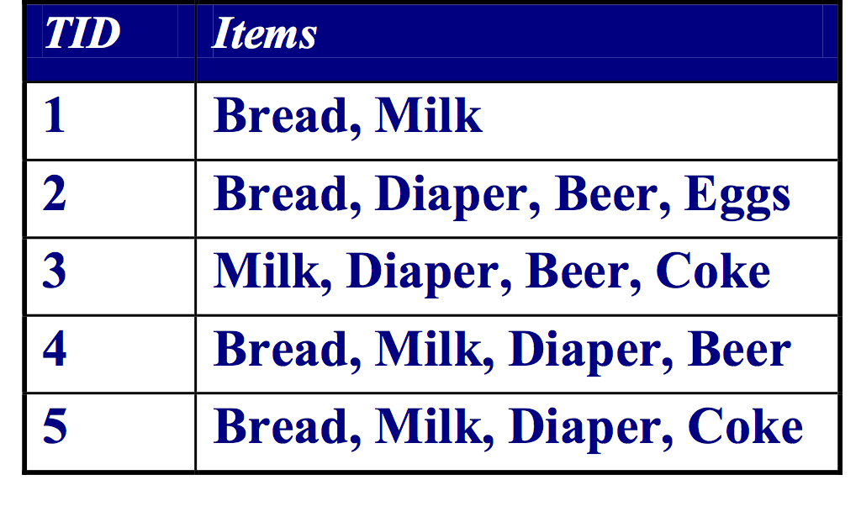
Definition: Association Rule
Association Rule
An implication expression of the form X → Y, where X and Y are non-overlapping itemsets
Example: {Milk, Diaper} → {Beer}
Rule Evaluation Metrics
Support (s)‏
Fraction of transactions that contain both X and Y
Confidence (c)‏
Measures how often items in Y appear in transactions that contain X
Example:

Slide 52
Computing support and confidence
TID date items_bought
100 10/10/99 {F,A,D,B}
200 15/10/99 {D,A,C,E,B}
300 19/10/99 {C,A,B,E}
400 20/10/99 {B,A,D}
What is the support and confidence of the rule: {B,D} → {A}
Support:
percentage of tuples that contain {A,B,D} =
75%
Confidence:
100%

Slide 53
Association-rule mining task
Given a set of transactions D, the goal of association rule mining is to find all rules having
support ≥ minsup threshold
confidence ≥ minconf threshold
Beyond the scope of the current course!

Slide 54
Direct discrimination
Direct discrimination implies rules or procedures that impose ‘disproportionate burdens’ on minorities
Potentially Discriminatory (PD) rules are any classification rule of the form:
A, B → C
where A is a PD group (B is called a "context")
Example:
gender="female", saving_status="no known savings"
→ credit=no

Slide 55
Favoritist PD rules
Favoritist PD rules
Is unveiled by looking at PD rules of the form
A, B → C
Check favoritism
where C grants some benefit and A refers to a favored group.
PD rules
Example:
gender="male", savings="no known savings"
Dataset with favored items
→ credit=yes

Slide 56
Indirect discrimination
Indirect discrimination implies rules or procedures that impose ‘disproportionate burdens’ on minorities, though not explicitly using discriminatory attributes
Potentially non-discriminatory (PND) rules may unveil discrimination, and are of the form:
D, B → C where D is a PND group
Example:
neighborhood="10451", city="NYC"
→ credit=no

Slide 57
Indirect discrimination example
Suppose we know that with high confidence:
neighborhood=10451, city=NYC → benefit=deny
But we also know that with high confidence:
neighborhood=10451, city=NYC → race=black
Hence:
race=black, neighborhood=10451, city=NYC → benefit=deny
Rule (b) is background knowledge that allows us to infer (c), which shows that
rule (a) is indirectly discriminating against blacks

Slide 58
Evaluating PD rules through the extended lift
Remembering that conf(X → Y) = support(X → Y) / support(X)
We define the extended lift with respect to B of rule A, B → C as: elift_{B}(A, B → C) = conf(A, B → C) / conf(B → C)
The rules we care about are PD rules such that:
A is a protected group (e.g. female, black)
B is a context (e.g. lives in San Francisco)
C is an outcome (usually negative, e.g., deny a loan)

Slide 59
The concept of α-protection
For a given threshold α, we say that PD rule A, B → C, involving a PD group A in a context B for an outcome C, is α-protective if:
elift_{B}(A, B → C) = conf(A, B → C) / conf(B → C) ≤ α
Otherwise, when elift_{B}(A, B → C) > α, then we say that
A, B → C is an α-discriminatory rule

Slide 60
Relation of α-protection and group representation
For a given threshold α, we say that PD rule A, B → C,
involving a PD group A in a context B for a (usually bad) outcome C, is α-protective if:
elift_{B}(A, B → C) = conf(A, B → C) / conf(B → C) ≤ α Note that:
elift_{B}(A, B → C) = elift_{B}(B, C → A) = conf(B, C → A) / conf(B → A)
This means extended lift is the ratio between the proportion of the disadvantaged group A in context B for (bad) outcome C, over the overall proportion of A in B.

Slide 61
Direct discrimination example
Rule (a):
Rule (b):
city="NYC"
→ benefit=deny with confidence 0.25
race="black", city="NYC"
→ benefit=deny
with confidence 0.75 elift 3.0
Additional (discriminatory) element increases the rule confidence up to 3 times.
According to α-protection method, if the threshold α=3 is fixed then the rule (b) is classified as discriminatory

Slide 62
Real-world example from German credit dataset
Fixing α=3:
(B) saving status = "no known savings" → credit = deny | conf. 0.18
(A) personal status = "female div/sep/mar", saving status = "no known savings" → credit = deny | conf. 0.27 | elift 1.52
Rule A is α-protective.

Slide 63
Real-world example 2 from German credit dataset
Fixing α=3:
(B) purpose = "used car" → credit = deny | conf. 0.17
(A) age = "52.6+", personal status = "female div/sep/mar", purpose = "used car" → credit = deny | conf. 1.00 | elift 6.06
Rule A is α-discriminatory.

Slide 64
Genuine occupational requirements
Non-explainable
discriminatory PD rules
Supported by a PD rule of the form
A, B → C
Check genuine requirement through an inference model
where C denies some benefit, we search for PND rules of the form
PD rules
PND rules
D, B → C
such that D is a legitimate requirement, having the same effects of the PD rule
Dataset with discriminatory items
D. Pedreschi, S. Ruggieri and F. Turini (2009). Integrating induction and deduction for finding evidence of discrimination. In Proc. of International Conference on Artificial Intelligence and Law (pp. 157-166). ACM.

Slide 65
Example: genuine occupational requirement
(a) [A] gender="female", [B] city="NYC" → [C] hire=no conf. 0.58
[D] drive_truck="false", [B] city="NYC" → [C] hire=no
[A] gender="female", [B] city="NYC" → [D] drive_truck=false
conf. 0.81
conf. 0.91
Let p ∈ [0, 1]. Classification rule (a) A, B → C with A being a PD attribute, is a
instance of a PND rule (b) D, B → C, if:
D is a legitimate ground for the decision (i.e., accepted by law),
conf(D, B→ C) ≥ p · conf(A, B → C), and
conf(A, B → D) ≥ p.
If p is close to 1, there is no discrimination!
D. Pedreschi, S. Ruggieri and F. Turini (2009). Integrating induction and deduction for finding evidence of discrimination. In Proc. of International Conference on Artificial Intelligence and Law (pp. 157-166). ACM.

Slide 66
Indirect α-Discrimination
We derive a lower bound for indirect α-discrimination of PD classification rules given information available in PND rules (γ , δ) and information available from background rules (β₁, β₂)
Let D, B → C be a PND classification rule, and let:
γ = conf (D,B → C)
δ = conf (B → C) > 0
Let A be a PD itemset and let β₁, β₂ such that: conf (A,B → D) ≥ β₁
conf (D,B → A) ≥ β₂ > 0

Slide 67
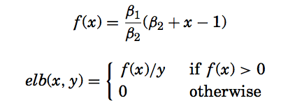
Indirect α-Discrimination

Slide 68
Related Lemmas

Slide 69
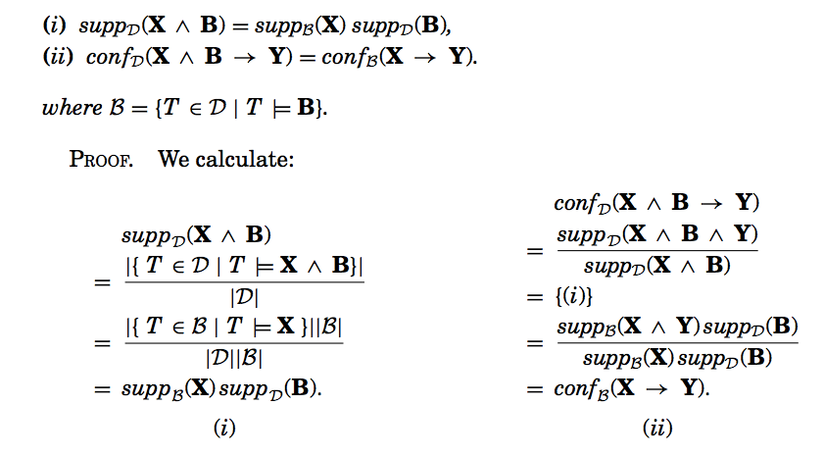
Related Lemmas

Slide 70
Related Lemmas
If
then

Slide 71
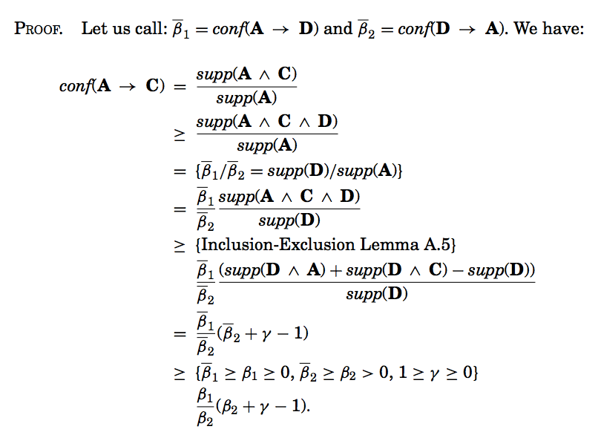
Proof of Lemma A.12

Slide 72
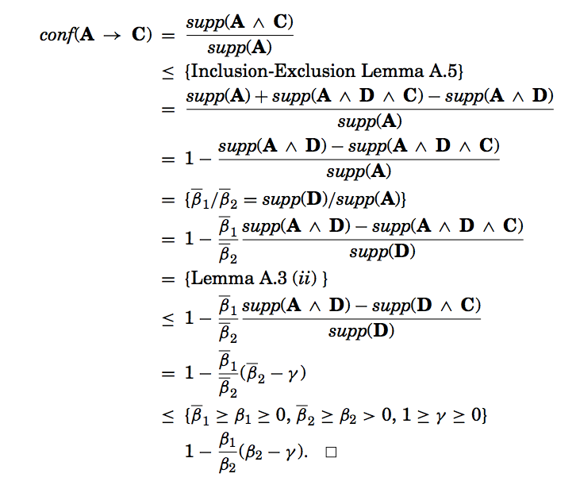
Proof of Lemma A.12

Slide 73
Recall: Indirect α-Discrimination

Slide 74
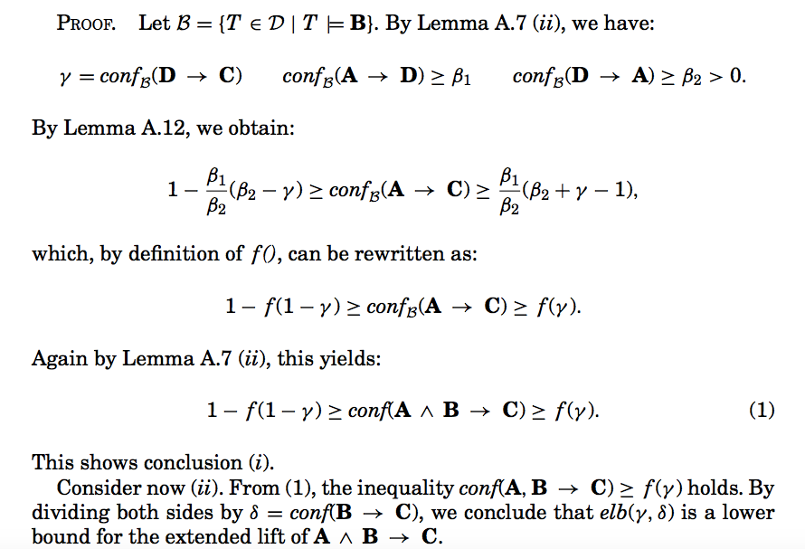
Proof

Slide 75
Discrimination discovery
Definition
Classification rule mining k-NN classification Bayesian networks Probabilistic causation Privacy attack strategies
Data mining approaches
Case studies
Discrimination discovery on the web
B. T. Luong, S. Ruggieri, and F. Turini (2011). k-NN as an implementation of situation testing for discrimination discovery and prevention. KDD'11

Slide 76
Limitations of classification rules approach
Legal limitations
Measuring group discrimination by aggregated values over undifferentiated groups is opposable in a court of law.
Take the context of women as the protected group and job hiring as the benefit. Approaches using aggregated values mix decisions for people that may be very different as per skills required for the job.
For example, do women have the same characteristics of men they are compared with? Or do they differ as per skills or other legally admissible reasons?

Slide 77
Limitations of classification rules approach (cont.)
Interpretational limitations
The result of the knowledge discovery process is a large set of classification rules, which provide local niches of possible discrimination.
No global description of who is discriminated and who is not.
Technical limitations
Due to the use of frequent itemset mining, it can only consider nominal attributes and nominal decisions
Interval-scaled attributes (age, income) and decisions (loan rate, wage) must be discretized as a pre-processing step.

Slide 78
Situation testing
Legal approach for creating controlled experiments
Matched pairs undergo the same situation, e.g. apply for a job
Same characteristics apart from the discrimination ground (a black and a white, a male and a female etc.)

Slide 79
Idea: k-NN as situation testing
Given past decision records, for each member of the
protected group with a negative decision outcome,
k-NN is applied to search testers with similar, legally admissible, characteristics.
If decision outcomes between the testers of protected and unprotected groups are different, then there is discrimination.

Slide 80
k-NN as situation testing
Input: a dataset R of decision records
For r ∈ R, dec(r) is the decision (discrete or continuous)
E.g., dec(r) is grant-benefit or deny-benefit
P(R) is the set of protected-by-law groups, e.g., women
E.g., P(R) = {r ∈ R | r[gender]=female}
U(R) = R \ P(R) is the rest of the dataset, e.g., men
Relax the "identical characteristics" of situation testing to a "similar characteristics" by using a distance function d

Slide 81
Distance function in k-NN
Distance d(a,b) is defined over attributes that are legally admissible for the purpose of taking the decision
Interval-scaled values are first standardized using the z-score z_{i}(x) = (x−m_{i})/s_{i}
where m_{i} is the mean value.
Then Distance between x,y is measured by the absolute difference of their z-scores:
For nominal domains, distance is a binary function testing equality:

Slide 82
k-NN as situation testing (the algorithm)
For r ∈ P(R), look at its k closest neighbors
... in the protected set
define p₁ = proportion with the same decision as r
… in the unprotected set
define p₂ = proportion with the same decision as r
knn (r,k)
P = Women U = Men
k = 4
p₁ = 0.75
p₂ = 0.25
P
knn (r,k)
U

Slide 83
k-NN as situation testing (the algorithm)
measure the degree of discrimination of the decision for r
define diff(r) = p₁ - p₂
If decision=deny-benefit, and diff(r) ≥ t > 0, then we found discrimination around r
knn (r,k)
knn (r,k)
P
U
p₁ = 0.75
p₂ = 0.25
diff(r) = p₁ - p₂ = 0.50

Slide 84
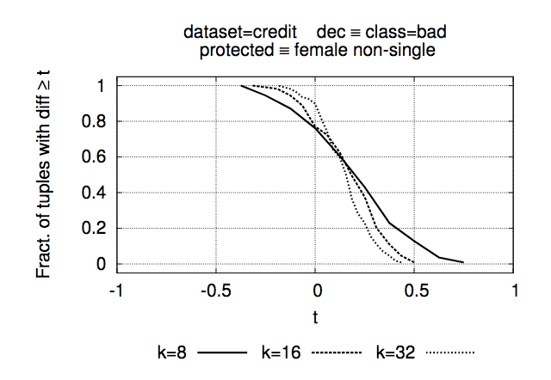
Results from German Credit Dataset
60% of non-single women have
diff(r) ≥ 0.1
So, bad-debtors are at least 10% more frequent among k-most similar persons in protected group than among k-most similar persons in unprotected group.

Slide 85
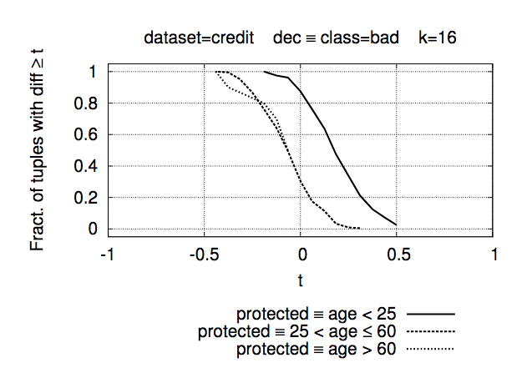
Results from German Credit Dataset
Cumulative distribution of
diff() for protected groups defined on ranges of age.
The plot clearly shows that youngsters suffer from a higher bias towards the bad-debtor classification than middle-age or older people.

Slide 86
Characterizing discrimination using k-NN
For r ∈ P(R), set a new attribute: "t-discriminated"
If dec(r) = deny-benefit and diff(r) ≥ t, t-discriminated(r) := TRUE
Otherwise t-discriminated(r) := FALSE
Example: for t=0.3 the sample r below is classified as t-discriminated
knn (r,k)
p₁ = 0.75
p₂ = 0.25
diff(r) = p₁ - p₂ = 0.50
P
knn (r,k)
U

Slide 87
How should t be chosen?
The answer depends on the law.
The U.K. legislation for sex discrimination (Sex Discrimination Act, 1975)
sets t = 0.05, namely a 5% difference.

Slide 88
Discrimination discovery using k-NN
To answer the question: under which conditions a protected group was t-discriminated?
Create t-labeled version of a dataset P(R) by (i) including records of only protected people (ii) adding binary attribute disc (which is true if protected group is t-discriminated and false otherwise).
Create a classifier (Decision Tree or Classification Rules) with training set P(R)
Analyze the classifier to learn discrimination rules.

Slide 89
Example discrimination rules found using DiscoveryN
German credit dataset
protected = female non-single
0.10-discriminated cases
Decision tree model (C4.5)
Discriminated women had no dependents (children) and were asking for small amounts
Classification rule model (RIPPER)
Discriminated women were asking for small amounts and were either paying in many installments or had been resident for a short time

Slide 90
k-NN for discrimination prevention
Goals of non-discriminating classifier:
Maximize classifier accuracy
e.g., give credit to people who will pay
Minimize t-discriminated cases
e.g., give credit to women if similar men would have been given credit
Basic idea: t-correction of training set
Flip the labels from negative to positive for t-discriminated cases in the training set

Slide 91
k-NN for discrimination prevention (results)
Original Train Data
t-Corrected Data
Only the training set changes, the testing set is fixed
Accuracy shows a small decrease
0.10-discrimination reduces substantially
There will always be an accuracy-fairness tradeoff. But the approach works well.
Dataset: Income Predictions on Census Data (aka "Census Income" dataset) https://archive.ics.uci.edu/ml/datasets/Adult

Slide 92
Discrimination discovery
Definition
Classification rule mining k-NN classification Bayesian networks Probabilistic causation Privacy attack strategies
Data mining approaches
Case studies
Discrimination discovery on the web
K. Mancuhan and C. Clifton (2014). Combating discrimination using bayesian networks. In Artificial Intelligence and Law, 22(2).

Slide 93
Let's go back to the classification-based approach
It hinges on computing elift_{B}(A, B → C) = conf(A, B → C) / conf(B → C)
What are these quantities? conf(A, B → C)
is the confidence on an outcome given a protected attribute and a context conf(B → C)
is the confidence on an outcome given just the context
conf(A, B → C) essentially estimates the P(C|A,B) class probability

Slide 94
Problem with calculating elift
Let A be the protected attributes, B the context (unprotected attributes)
Suppose we have a way of computing P(benefit=deny|...)
Suppose we use it to classify people: P(benefit=deny|...) ≥ θ ⇒ deny_benefit
If P(benefit=deny|A, B) / P(benefit=deny|B) ≥ α, then we could say that the classifier is α-discriminatory
elift assumes that attributes in A, B item sets are independent from each other

Slide 95
Extending the elift idea
Let A be the protected attributes, B the context (unprotected attributes)
Let R be "redlining" attributes, which are correlated with the protected attributes A Suppose we have a way of computing P(benefit=deny|...)
Suppose we use it to classify people: P(benefit=deny|...) ≥ θ ⇒ deny_benefit
If P(benefit=deny|A, B, R) / P(benefit=deny|B) ≥ α,
then we could say that the classifier is α-discriminatory

Slide 96
Bayesian networks
Bayesian networks estimate the probability P(A, B, C) by capturing the conditional dependencies between the attributes within the sets A and B.
P(C|A,B) class probability can be derived from the Bayes' theorem
P(Y|X) = P(X|Y)P(Y)
P(X)
P(Y|X,E) = P(X|Y,E) P(Y|E)
P(X|E)

Slide 97
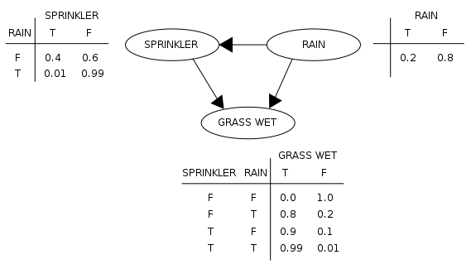
Bayesian networks
Suppose that there are two events which could cause grass to be wet: either the sprinkler is on or it's raining.
Then the situation can be modeled with a Bayesian network (shown to the right)
The joint probability function is:
Pr ( G , S , R ) = Pr ( G | S , R ) Pr ( S | R ) Pr ( R )
where G = Grass wet (yes/no), S = Sprinkler turned on (yes/no), and R = Raining (yes/no).

Slide 98
Bayesian networks
The model can answer questions like "What is the probability that it is raining, given the grass is wet?"
Using the conditional probability tables from the diagram

Slide 99
Back to computing elift
Bayesian networks can capture correlations between attributes
The elift can be extended to belift by calculating the numerator and the denominator probabilities with Bayesian networks
It identifies changes in decision making due to the usage of protected and redlining attributes
It captures both direct and indirect discrimination

Slide 100
Bayesian elift (belift)
A
B
R
B
This indicates how many times the usage of protected attributes (A) and the redlining attributes (R) increase the class probability for a given instance with respect to its probability using only non-protected attributes (B)

Slide 101
Bayesian networks for discrimination discovery
Build a Bayesian network net from the decision records D
Build a second Bayesian network (relative_net) by removing protected attributes and the parents and children of them (i.e., neighbors) in net
The neighboring nodes of the protected attributes form the set of redlining attributes because they have the highest correlation in the entire data.
Thus, redlining attributes could lead to indirect discrimination.

Slide 102
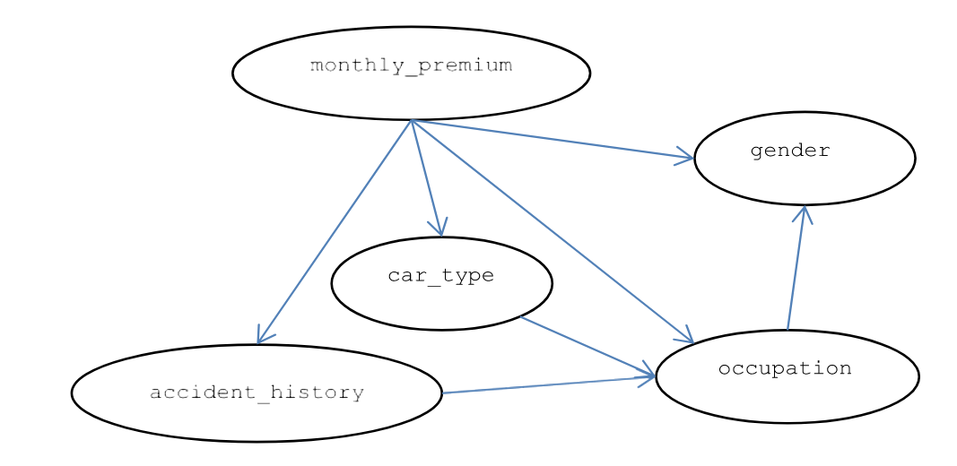
Example: net and relative_net
Decision Outcome
Protected attribute
Redlining attribute
After removing protected and redlining attributes
Bayesian Network constructed from data

Slide 103
Bayesian networks for discrimination discovery
For each instance i in the decision records, consider net and relative_net, compute probability of target class and apply decision threshold.
If the decision is the same, ignore: instance was not discriminated
If the decision is different (i.e., there is a "decision flip" when adding protected and redlining attributes): compute belift
If belift ≥ α, then instance i is discriminatory

Slide 104
Bayesian networks for discrimination prevention
Build a Bayesian network from a given set of instances D (net)
Build a non-discriminatory Bayesian network from net (nd_net)
Remove the protected attribute nodes from net, but keep the redlining attribute nodes (to achieve high accuracy)
Correct the dataset by flipping the class label of discriminated instances (mitigates the effect of direct and indirect discrimination)
Update probability tables of nd_net using the corrected dataset
Return the non-discriminatory Bayesian network (nd_net)

Slide 105
Discrimination discovery
Definition
Classification rule mining k-NN classification Bayesian networks Probabilistic causation Privacy attack strategies
Data mining approaches
Case studies
Discrimination discovery on the web
F. Bonchi, S. Hajian, B. Mishra, and D. Ramazzotti (2015). Exposing the probabilistic causal structure of discrimination. arXiv:1510.00552.

Slide 106
Correlation is not causation
Causation and correlation can happen at the same time.
But having a correlation does not always mean you have a causation.
A good example of this:
There is a positive correlation between the number of firemen fighting a fire and the size of the fire. This means the more people at the fire, tends to reflect how big the fire is. However, this doesn’t mean that bringing more firemen will cause the size of the fire to increase.
Causation is any cause that produces an effect.
Correlation measures the relationship between two things.

Slide 107
Limitation of previous approaches to find causality
Legal limitations
Any legally-valid proof of discrimination requires evidence of causality [Foster, 2004]
Technical limitations
The state-of-the-art methods are essentially correlation-based
Spurious correlations can lead to false negatives and false positives
A Bayesian network would not be able to disentangle the direction of any causal relationship
Sheila R. Foster (2004). Causation in Antidiscrimination Law: Beyond Intent Versus Impact. Houston Law Review 41, p. 1469

Slide 108
What do we need to prove discrimination?
Discrimination is causal
We need to assess discrimination as a causal inference problem from a database of past decisions, where causality can be inferred probabilistically.
Here the data mining problem is to unveil discriminatory practices by analyzing a dataset of historical decision records

Slide 109
State of art causality checking paradigms
Constraint based learning explicitly tests for pairwise independence of
variables conditioned on the power set of the rest of the
variables in the network.
Score based learning constructs a network which maximizes the likelihood of the observed data with some regularization constraints to avoid overfit-
ting.

Slide 110
Suppes probabilistic causation theory (constraints)
Let h denote cause, e denote effect
Temporal priority
Any cause must happen before its effect: t_{h} < t_{e}
Probability raising
Cause must raise the probability of observing the effect:
P(e | h) > P( e | ¬h)

Slide 111
A Supp’s constrained based approach for causality detection
Build a constrained Bayesian network reconstructed by means of maximum likelihood estimation (MLE) from the given database
Force the conditional probability distributions induced by the reconstructed graph to obey Suppes’ constraints: i.e., temporal priority and probability rising.

Slide 112
Building Suppes-Bayes Causal Network (SBCN)
[Temporal priority]
“income = low” cannot be a cause of “gender = female”, because the time when the gender of an individual is determined is antecedent to that of when the income is determined.
This intuition is implemented the data analysts who provide as input to SBCN a partial temporal order r : A → N for the h attributes
Based on the input dataset D and the partial order r the first graph G = (V, E) is produced for each of the Bernoulli variables, so |V | = m, and an arc (u, v) ∈ E whenever r(u) ≤ r(v).

Slide 113
Building Suppes-Bayes Causal Network (SBCN)
[Probability raising]
Given the graph G = (V, E) built as described above the next step requires to prune the arcs which do not satisfy the second constraint, probability raising, thus building G 0 = (V, E 0 ), where E 0 ⊆ E.
Remove edges arc (u, v) from E such that P(v | u) ≤ P(v | ¬u).

Slide 114
The Suppes-Bayes Causal Network (SBCN)
Represents the causal structures existing among the attributes in the data by a constrained Bayesian network:
Each node represents an assignment <attribute=value>
Each arc (u,v) represents the existence of a relation between u and v satisfying Suppes' constraints (temporal priority and probability raising)
Each arc is labeled with a positive weight: p(u|v) - p(u|¬v)

Slide 115
Network simplification
Suppes’ conditions are necessary but not sufficient to evaluate causation
Remove arches with a score based approach, specifically by relying on the Bayesian Information Criterion (BIC) as the regularized likelihood score
Inputs for this score the graph G’ and the dataset D’ . Given these, select the set of arcs E* ⊆ E ‘ that maximizes the score:

Slide 116
The Suppes-Bayes Causal Network (SBCN)
Reconstructed from the data using maximum likelihood estimation (MLE), where we force the conditional probability distributions induced by the reconstructed graph to obey Suppes’ constraints
Network simplification by extracting a minimal set of edges which best explain the data. This
regularization is done by means of the Bayesian Information Criterion (BIC)
Bayesian information criterion (BIC) or Schwarz criterion (also SBC, SBIC) is a criterion for model selection among a finite set of models;
Notes:
In statistics, the Bayesian information criterion (BIC) or Schwarz criterion (also SBC, SBIC) is a criterion for model selection among a finite set of models; the model with the lowest BIC is preferred. It is based, in part, on the likelihood function and it is closely related to the Akaike information criterion (AIC).
he BIC is formally defined as^{[2]}
B I C = ln ⁡ ( n ) k − 2 ln ⁡ ( L ^ ) . {\displaystyle \mathrm {BIC} ={\ln(n)k-2\ln({\hat {L}})}.\ }
where
L ^ {\displaystyle {\hat {L}}} = the maximized value of the likelihood function of the model M {\displaystyle M} , i.e. L ^ = p ( x | θ ^ , M ) {\displaystyle {\hat {L}}=p(x|{\hat {\theta }},M)} , where θ ^ {\displaystyle {\hat {\theta }}} are the parameter values that maximize the likelihood function;
x {\displaystyle x} = the observed data;
n {\displaystyle n} = the number of data points in x {\displaystyle x} , the number of observations, or equivalently, the sample size;
k {\displaystyle k} = the number of parameters estimated by the model. If the model under consideration is a multiple linear regression, then the estimated parameters are the intercept, q {\displaystyle q} slope parameters and the constant variance of the errors. Thus, k = q + 2 {\displaystyle k=q+2} ;

Slide 117
Derivables
Using the reconstructed SBCN, the probabilistic relationships between any set of events (nodes) can be represented.
Example: suppose to consider the nodes represent-
ing respectively income = low and gender = female being the only two direct causes (i.e., with arcs toward) of loan = denial. SBCN can estimate the conditional probabilities for each node in the graph, i.e., probability of
p(loan = denial | income = low ^ gender = female)
in the example, by computing the conditional probability of only the pair of nodes directly connected by an arc.

Slide 118
SBCN example: Census Income dataset
https://archive.ics.uci.edu/ml/datasets/Adult

Slide 119
Graph representation allows interesting applications
Two largest communities detected using the Walktrap algorithm [Pons and Latapy 2006]
age (ag), education (ed), marital status (ms), native country (nc), occupation (oc), race(ra),
relationship (re), sex (sx), workclass (wc)
P. Pons and M. Latapy (2006). "Computing communities in large networks using random walks." J. Graph Algorithms Appl. 10.2: 191-218.

Slide 120
Discrimination discovery using random walks
Our task is to assign a score of discrimination ds − : V → [0, 1]
to each node, so that the closer ds − (v) is to 1 the more discriminated
is the group represented by v.
Start from the node we want to test (e.g. gender=female)
Let δ+ represent the positive outcome node (e.g., high salary) δ- the negative outcome (e.g., low salary)

Slide 121
Discrimination discovery using random walks
Perform n random walks starting from v
Let rw(v → δ-) be the number of random walks starting from v and ending in δ- People with attribute v are discriminated if the fraction is large
Indirect discrimination also can be captured by this method

Slide 122
Genuine requirement
The legal concept of genuine requirement refers to detecting that part of the discrimination which may be explained by other, legally-grounded, attributes;
Eg: denying credit to women may be explainable by the fact that most of them
have low salary or delay in returning previous credits.
Let v ∈ V be the node representing the group which is suspected of being discriminated, and u_l ∈ V be a node whose causal relation with a negative or positive decision is legally grounded. As before, δ − and δ + denote the negative and positive decision, respectively.

Slide 123
Individual and subgroup discrimination
Subgroup discrimination refers to discrimination against a subgroup described by a combination of multiple protected and non-protected attributes: personal data, demographics, social, economic and cultural indicators, etc.
In order to define a discrimination score for v1 , . vn , we perform a personalized PageRank computation with respect to v1 , . . . , vn , denotes of proximity/relevance to {v1, … , vn } for each other node u
let δ − ∈ V and δ + ∈ V denote the nodes indicating the negative and positive decision

Slide 124
Result: top discriminated groups
Census Income Dataset
German credit dataset
Discriminated with respect to “Income”
Discriminated with respect to “Credit Permit”

Slide 125
Result: fraction of explainable discrimination

Slide 126
Discrimination discovery
Definition
Classification rule mining k-NN classification Bayesian networks Probabilistic causation Privacy attack strategies
Data mining approaches
Case studies
Discrimination discovery on the web
S. Ruggieri, S. Hajian, F. Kamiran, X. Zhang (2014). Anti-discrimination analysis using privacy attack strategies. In PKDD'14.

Slide 127
Assumptions of existing strategies
The dataset explicitly contains an attribute denoting the PD group
May not always hold. Then it becomes an indirect discrimination discovery problem.
The dataset has not been pre-processed prior to discrimination discovery
The data may contain attributes denoting protected groups but such data have been pre-processed to control the (privacy) risks of revealing confidential information.
Finding discrimination in this scenario is termed as privacy-aware discrimination discovery.

Slide 128
Discrimination discovery scenarios
Indirect discrimination discovery
Privacy-aware discrimination discovery
(e.g., original data with all attributes is no longer available)
Discrimination data recovery
(e.g., original data with all attributes has been hidden from authorities)

Slide 129
Discrimination discovery scenarios: Intuition
Indirect discrimination discovery
Privacy-aware discrimination discovery
Discrimination data recovery
There is an interesting parallel between the role of the anti-discrimination authority in these three scenarios and
the role of an attacker in private data publishing
The discrimination authority must infer who belongs to a protected group, based on the decisions that have been made.

Slide 130
Discrimination discovery scenarios: Attack scenario
Indirect discrimination discovery
(the anti-discrimination authority has to infer personal data e.g., gender/race of individuals in the dataset under investigation)
Privacy-aware discrimination discovery
(the authority has to find out as much information as possible on the membership of individuals in the protected group)
Discrimination data recovery
(reconstructing original decisions from a perturbed dataset)

Slide 131
Privacy attack strategies
Combinatorial attacks based on Frèchet bounds inference
Attribute inference attacks
Minimality attacks
Key Idea:
The anti-discrimination authority can utilize additional information (background knowledge) to unveil contexts of possible discrimination from the data released by data owner.

Slide 132
We will use risk difference (RD)
A discrimination table is α-protective (w.r.t. the risk difference
measure RD) if RD ≤ α. Otherwise, it is α-discriminatory.
We could apply classification rules if sensitive attributes were present in data

Slide 133
Indirect discrimination discovery
Think of g₁ and g₂ as redlining attributes (i.e., correlated with being protected)
We want to derive bounds on a discrimination measure for an unknown contingency table given a known/released contingency table and an additional background knowledge contingency table

Slide 134
Indirect discrimination discovery
Exploit Frèchet bounds!
If n_{X} is support of an itemset X, then the Frèchet bounds for the support of two itemsets X and Y are given as

Slide 135
Indirect discrimination discovery
We can decompose unknown value a into the number a₁ of individuals in group g1 plus the number a₂ of individuals in g2: a = a₁ + a₂
Let X be (rel. group="g1" and dec=“-") and Y be (rel. group="g1" and group= “protected”), then a₁ = n_{XY} and the bounds are
Using Frèchet bound
min{n_{X}, n_{Y}} ≥ n_{XY} ≥ max{n_{X} + n_{Y} - n_{X∩Y} , 0}

Slide 136
Indirect discrimination discovery
We do the same with a₂, and a similar decomposition for c, obtaining:
Lower bound
Uses only known and background data
113

Slide 137
Privacy-aware discrimination discovery
Original dataset includes an attribute that explicitly identifies the protected group
Released dataset were pre-processed using a privacy-preserving inference control method
to diminish the correlation between such an attribute and other non-sensitive attributes
There could be different purposes for data sanitization:
To protect individuals’ sensitive information
To use data privacy as an excuse for hiding discriminatory practices
In both cases, the anti-discrimination authority has to unveil discrimination
from the sanitized data

Slide 138
Privacy-aware discrimination discovery
Privacy-preserving inference control methods include bucketization.
The output of bucketization consists of two tables:
(i) a non-sensitive table (containing entire non-sensitive attributes information,
then tuples are partitioned into groups, a unique GID is assigned to each group), and
(ii) a sensitive table (containing the sensitive values that appear in a specific group)
Privacy-aware discrimination discovery is about deriving bounds on a discrimination measure for an unknown contingency table given the bucketized dataset R′

Slide 139
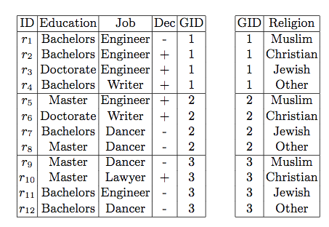
Privacy-aware discrimination discovery
Tuple r1 in group GID = 1 has probability 25% of referring to a Muslim, Christian, Jewish, or Other individual, but it is impossible to determine which case actually holds. Thus, for the bucketized version R′ of a dataset R, the correlation between sensitive attribute and non-sensitive attributes is diminished.

Slide 140
Privacy-aware discrimination discovery
For each group in R’, every sensitive value is distinct and the group size l is the cardinality of the attribute denoting protected and unprotected groups, e.g., the number of religions.
In privacy research, this is known as l-diversity privacy model.
Privacy-aware discrimination discovery is about deriving bounds on a discrimination measure for an unknown contingency table given the bucketized dataset R′

Slide 141
Privacy-aware discrimination discovery
Non-sensitive Sensitive Unknown
When restricting to education=bachelors, n₁ becomes muslim bachelors;
n₁ is always required as input
Frèchet bounds
n^{i} = people in group i
n₁ = total number of protected people

Slide 142
Discrimination data recovery
Data owner hides discrimination by flipping a minimum number of decisions
Releases R' with changed decisions to have RD(R')=0, but we want R
Suppose we know the original risk difference RD(R)
Discrimination affects the tuples close to the decision boundary of a classifier
To determine the decision boundary, we rank tuples of the protected and unprotected groups separately w.r.t. their positive decision probabilities accordingly to a classifier trained from the transformed data R'
We don't fix all data at the same time, but iteratively, re-training at each iter.

Slide 143
Results: indirect discrimination discovery

Slide 144
Discrimination discovery
Definition
Data mining approaches
Case studies
Discrimination discovery on the web

Slide 145
Crime suspect dataset
Dataset: a real world dataset of Statistics Netherlands, which is a census body in the Netherlands.
Application: the use of classifiers for predicting whether an individual is a crime suspect, or not, to support law enforcement and security agencies.
Results:
The results show that discrimination does exist in real world datasets and blind use of classifiers learned over such datasets can exacerbate the discrimination problem.
It demonstrates that discrimination-aware classification methods can mitigate the discriminatory effects and that they lead to rational and legally acceptable decisions.
F. Kamiran, A. Karim, S. Verwer and H. Goudriaan (2012). Classifying socially sensitive data without discrimination: An analysis of a crime suspect dataset. In ICDMW, pp. 370-377.

Slide 146
Scientific project evaluation
Dataset: scientific research proposals
In 2008, the Italian Ministry of University and Research published a call for scientific research projects under the Basic Research Investment Fund (FIRB) reserved to young scientists.
Method: classification rule mining and k-NN classification approaches to discover gender bias in scientific research funding
A. Romei, S. Ruggieri and F. Turini (2013). Discrimination discovery in scientific project evaluation: A case study. In Expert Systems with Applications, 40(15).

Slide 147
Discrimination discovery
Definition
Data mining approaches Case studies
Discrimination discovery on the web

Slide 148
Discrimination in online services is not rare
Non-black hosts can charge ~12% more than black hosts in Airbnb
Edelman, Benjamin G. and Luca, Michael, Digital Discrimination: The Case of Airbnb.com (January 10, 2014). Harvard Business School NOM Unit Working Paper No. 14-054.
Price steering and discrimination in many online retailers
Aniko Hannak, Gary Soeller, David Lazer, Alan Mislove, and Christo Wilson: Measuring Price
Discrimination and Steering on E-commerce Web Sites. Proc. of IMC. Vancouver, Canada, November 2014.
China is about 21% larger by pixels when shown in Google Maps for China
Gary Soeller, Karrie Karahalios, Christian Sandvig, and Christo Wilson: MapWatch: Detecting
and Monitoring International Border Personalization on Online Maps. Proc. of WWW. Montreal, Quebec, Canada, April 2016
Examples from WWW'16 tutorial by Strohmeier, Aiello, Wagner, and Weber: https://sites.google.com/site/csswwwtutorial/slides

Slide 149
Discrimination discovery on the web
How do we measure the “fairness of the web”?
Need to model/understand user browsing behavior
Evaluate how web sites respond to different behavior/attributes
Cope with noisy measurements
Moritz Hardt (2013). Fairness through Awareness Presentation (slides).
Mikians, J., Gyarmati, L., Erramilli, V., and Laoutaris, N. (2012). Detecting price and search discrimination on the internet. In Proceedings of the 11th ACM Workshop on Hot Topics in Networks, pages 79–84. ACM

Slide 150
The importance of being Latanya
Names used predominantly by black men and women are much more likely to generate ads related to arrest records, than names used predominantly by white men and women.
Discovered by researcher Latanya Sweeney.
L. Sweeney (2013). Discrimination in online ad delivery. Queue, 11(3). See also N. Newman (2011) in Huffington Post.

Slide 151
The dark side of Google Ads
AdFisher: tool to automate the creation of behavioral and demographic profiles.
Used to demonstrate that setting gender = female results in less ads for high-paying jobs.
A. Datta, M. C. Tschantz, and A. Datta (2015). Automated experiments on ad privacy settings. Proceedings on Privacy Enhancing Technologies, 2015(1):92–112.

Slide 152
Adfisher tool to uncover discrimination in ads
A. Datta, M. C. Tschantz, and A. Datta (2015). Automated experiments on ad privacy settings. Proceedings on Privacy Enhancing Technologies, 2015(1):92–112.

