Slide 1
Rural healthcare and telemedicine Jayanta Mukhopadhyay, Professor, Dept. of Computer Science & Engineering. Indian Institute of Technology, Kharagpur. jay@cse.iitkgp.ac.in

Slide 2
Public Health Foundation of India (PHFI) –Indicators for India
Health manpower (doctor, nurses and midwives) population ratio : 8/10,000
WHO recommended ratio of 25/10,000 population.
Private sector: 70%, out of which only 20% work in rural areas.
The doctor population ratio
rural areas: 3/10,000
urban areas: 13/10,000

Slide 3
Disease burden estimation
Global Burden of Disease Study 2016:
enables standardised comparisons of health loss caused by different diseases and risk factors, between geographic units, sexes, and age groups, and over time in a unified framework.
Disability-Adjusted Life Years (DALY): a key metric
the sum of the number of years of life lost due to premature death and a weighted measure of the years lived with disability due to a disease or injury.
recommended by India’s National Health Policy of 2017 to track disease burden .
India: Health of the Nation's States — The India State-Level Disease Burden Initiative. New Delhi: ICMR, PHFI, and IHME; 2017. ISBN 978-0-9976462-1-4.

Slide 4
Health Status in India: Improving but gaps increasing among states
Life expectancy at birth improved in India from 59.7 years in 1990 to 70.3 years in 2016 for females, and from 58.3 years to 66.9 years for males.
continuing inequalities between states
66.8 years (UP) - 78.7 years (Kerala) for females in 2016.
63.6 years (Assam) to 73.8 years (Kerala) for males in 2016.
Per person DALY rate dropped to 36 % from 1990 to 2016.
two-fold difference in this disease burden rate between the states in 2016, with Assam, Uttar Pradesh, and Chhattisgarh having the highest rates, and Kerala and Goa the lowest rates.
72% higher per person than in Sri Lanka or China in 2016.

Slide 5
Changing disease profile
communicable, maternal, neonatal, and nutritional diseases: 61% (1990), 33% (2016)
Non-communicable diseases: 30% (1990) , 50% (2016)
Wide variations among states: 48 – 75% (NC), 14- 43% (C), 9 – 14% (Injuries).
DALY rates
high among diarrhoeal disease (9-fold), lower respiratory infections (7-fold), and tuberculosis (9-fold) in 2016.
diarrhoeal disease, iron-deficiency anaemia, and lower respiratory infections higher among females.
tuberculosis higher among males.
child and maternal malnutrition single largest risk factor, responsible for 15% of the total disease burden in India in 2016.
10% by a group of risks including unhealthy diet, high blood pressure, high blood sugar, high cholesterol, and overweight, which mainly contribute to ischaemic heart disease, stroke, and diabetes (life style diseases).
Diseases due to tobacco use: 6%.

Slide 6
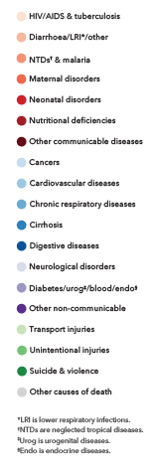
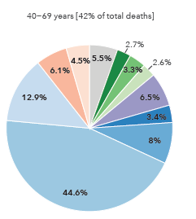
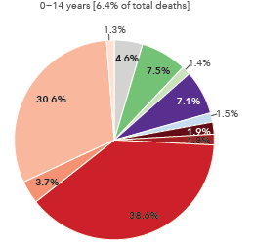
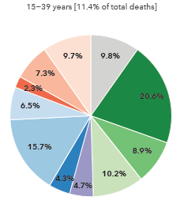
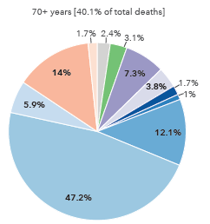
Causes of deaths in different age groups (2016)

Slide 7
Top 15 causes of Year of life lost (YLL) (2016)

Slide 8
Top 15 causes of Years lived with disability(YLD) (2016)

Slide 9
Top 10 risk factors (2016)

Slide 10
Rural Health Statistics
Norms of Population Coverage Under the Public Health Institutions in India
Shortfall of
20,486 SCs,
4,477 PHCs and
2,337 CHCs.
1,46,036 SCs,
23,458 PHCs, and
4,276 CHCs.

Slide 11
Healthcare Delivery System

Slide 12
Digital convergence and healthcare
Technological revolution
Mass adoption
Revolution in social interaction
Information deluge
Yet to see full scale adoption in healthcare delivery!
Why?
Our experience in telemedicine and other related projects in Govt. hospitals of West Bengal and Tripura.

Slide 13
What is telemedicine?
Remote consultation using ICT.
Doctor to doctor.
In presence or w/o presence of a patient.
Doctor to patient
Simple exchange of information
Patient’s data and medical advice.
Online communication not required.

Slide 14
Issues
Reliable exchange of information
Systematic and organized access of data
Security and privacy
Patient’s consent
User friendly interfaces
Time of consultation
Law and ethics
Legality of Medical advice on remote consultation
Informed consent from patient.
Scalability

Slide 15
Evolution of technology at a glance
Peer-to-peer system
Web-based client-server model
Mobile telemedicine or m-Medicine
Distributed telemedicine system
Telemedicine over cloud

Slide 16
Technology Development
TelemediK (2000-2003): A prototype working on POTS
Proprietary client server modules with low bandwidth data communication.
Supported by back-end RDBMS
Windows NT server
TelemdiK (2005-2009) : 1st Generation Telemedicine system
Use of open standards for data communication and representation, such as, internet browser, html, sftp, ssh, etc.
Peer to peer data communication.
Needed server and high end network equipment at every center.
Data exchange only through leased lines.

Slide 17
Technology Development
iMediK (2009-2013): 2nd Generation Telemedicine System
Web based centralized server.
Needed only a powerful server and other high-end network equipment in a central location.
Data exchange could take place in public domain also (internet).
Four layered architecture for secured data access.
Windows IIS server and dot net protocol for remote execution.
iMediX (2015 – 2017): 3rd Generation Telemedicine System
Seamless mobile device integration
PACS integration
Standardization
Use of open source software (Linux OS, Tomcat-Apache HTTPS server, MySQL RDBMS)

Slide 18
Technology Development
iMediX (2020-2021): 4th Generation
Blending hospital care with home care
Integration with VC (Open source Jitsi Meet), Email, SMS
Patient has a role
The current version.

Slide 19
Timeline: West Bengal
1997: Project Proposal on a Telemedicine Network (of 1 R + 2 N) using POTS.
1999: Project Sanctioning.
2000: 1st Telemed. System: TelemediK 1.0
2002: Network deployed and became operational.
2003: TelemediK 3.0
2004-2005: Expansion of Network (2R + 4N)

Slide 20
Timeline: West Bengal (contd.)
2005: TelemediK 2005
2005-2007: Expansion of Network (3 R + 5 N)
2008: iMediK: Web-based system with mobile interfaces.
2009: Installed in Medical College, Kolkata. Special focus to paediatric HIV patients.
2011: Project ended.
2018: Under a new initiative iMediX with PACS integration installed in Swasthya Bhavan, Dept. of Health and Family Welfare, West Bengal
2023: Project ended.

Slide 21
Deployment of Telemedicine – West Bengal
TelemediK-2005 deployed in 16 hospitals –
6 Referral Hospital in Kolkata.
10 Nodal Hospital in different districts.
iMediK installed
in Calcutta Medical
College in July 2009.
~ 5000 patients treated during 2001-2011.

Slide 22
Tripura Telemedicine Projects: (2005-2013)
Title of the project | Cost (Rs. In lakhs) | Duration | No. of centers | Significant Milestones
Setting up of Telemedicine Facility in Tripura (SUTF) | 287.0 | June 2005 – March 31, 2009 | Referral Centers: 2 Nodal Centers: 6 | Telemedicine network inauguration: 9th June, 2005
Deployment of Telemedicine in Tripura, Project II (DOTP) | 282.0 | April 2006 – March 2010 | Nodal Centers: 6 | More than 8000 patients treated by the network by 2010.
Deployment of Telemedicine at remote CHC/PHC in Tripura (CHCP) | 296.0 | Feb 2009 – January 2013 | Nodal Centers: 6 | 1st gen. system (TelemediK) -> 2nd. gen system (iMediK) in 2011. Number patients treated: More than 30000.

Slide 23
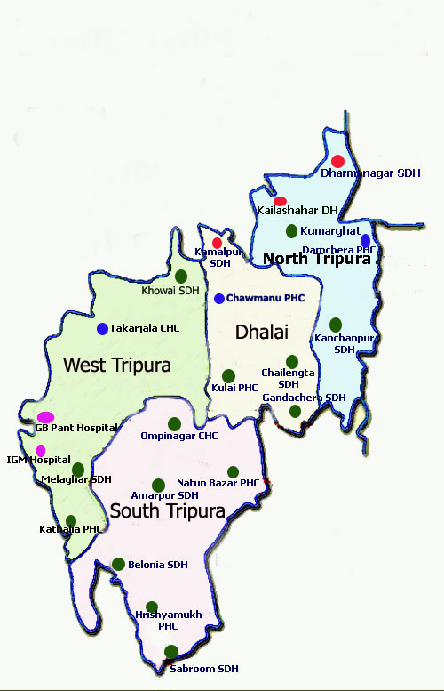
Location of Telemedicine Referral & Nodal Centers
Project operated till 2018 with the support from NRHM and initiative taken by Govt. of Tripura

Slide 24
Better managed with initiatives from the State Government
Implementation of Telemedicine in Tripura: A Case Study with Details for Replication, Centre for Innovations in Public Systems (CIPS), Hyderabad, Feb. 2014.

Slide 25
Five reasons for failure!
Clumsy solution – too many features – complicated to use – less user friendly - Adhocism.
Low acceptability to physicians – additional load, data entry time consuming, not feeling any requirement, ego of experts.
Context not appropriate – SHC to THC / PHC to THC/ PHC to SHC / Patient to Doctor / Other application ?
Lack of support and maintenance
Poor infrastructure

Slide 26
Single reason for success
Initiated by the health care provider!

Slide 27
Covid Pandemic: Need for homecare
Just not to handle an epidemic!
Aging population.
Increasing cost of hospitalization.
Avoiding risk of hospital induced infection.
Treating at home always a preferred mode.

Slide 28
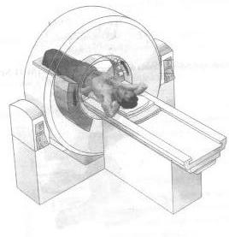
Traditional hospital based consultation
PACS Server
(Telerad)
Telemedicine server
Internet
Step 1.
Upload Information
step2.
Download Information
Step 4.
Receive Suggestion
Step 3b.
Post Suggestions
Step 3a.
Reporting on investigation
Referral Hospital
Nodal Hospital

Slide 29
Healthcare as homecare
SMS Gateway
Video Conferencing
System
Telemedicine Server
Email Gateway
Internet
step2.
Approve and
set an appointment data
Step 1.
Registration/Login
and
Request for Consultation
Step 4.
Receive advice.
Step 3b.
Prescribe and advise
Step 3a.
Consultaiton with VC
Doctor
Patient

Slide 30
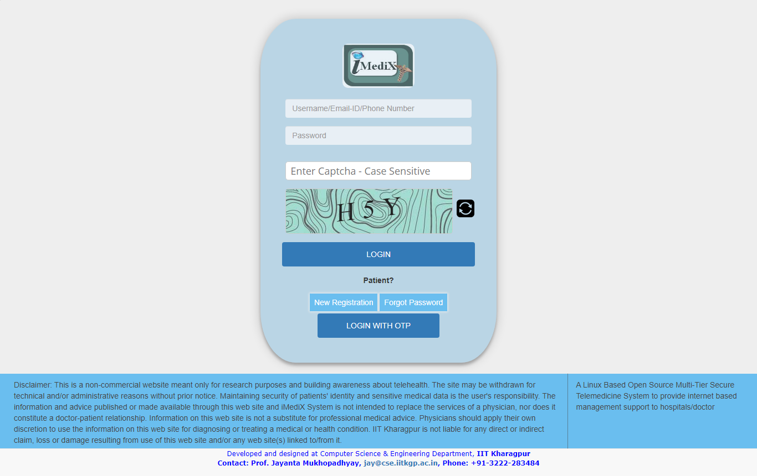
iMediX: healthcare as homecare
Roles:
Patient
Administrator
Data Entry Operator
Doctor
Medical technologist
Integrates homecare with healthcare services from the hospital.
Email and SMS messaging
Video conferencing
Telereferral
Multicentric
Four tier architecture
Mobile responsive
PACS integrated

Slide 31
Blending home consultation under hospital centric framework
A patient makes request for consultation.
A doctor is assigned.
Appointment scheduled and communicated to the patient.
Patient logs in on the appointed session, & gets updated status.
Doctor logs in and checks patient queue.
Doctor invites patient for VC
Patient accepts and VC session starts
Doctor prescribes and advises.
Prescription sent by Email and also available in the account.

Slide 32
Different scenarios
Traditional telemedicine
Hospital to hospital tele-referral and consultation.
Hospital to home consultation
Homecare
Community outreach program
by a pool of doctors across globe.
Direct consultation and follow-up.
Patient directly dials up.

Slide 33
iMediX made open source
A base version.
named iMediXcare
Limited features
Readily installable and usable telemedicine system modeling E-OPD / E-Clinic
May be customized to specific need
Inaugurated today for community healthcare program by Rama Krishna Mission Home of Service, Varanasi.
Link: https://github.com/jmGithub2021/iMediXcare
Appache licence

Slide 34
Covid Pandemic and thereafter
Commercial venture with a company at Kolkata.
Deployment in Dept. of Health and Family Welfare, Govt. of West Bengal
Integrated with the hospital at IIT Kharagpur
Deployed at Ramakrishna Mission Home of Services, Varanasi for their community outreach program.

Slide 35
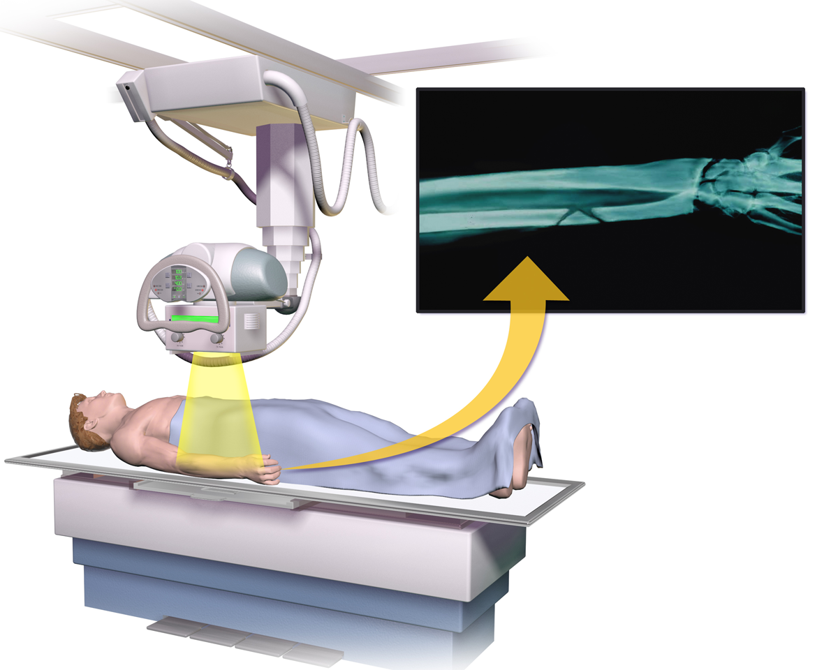
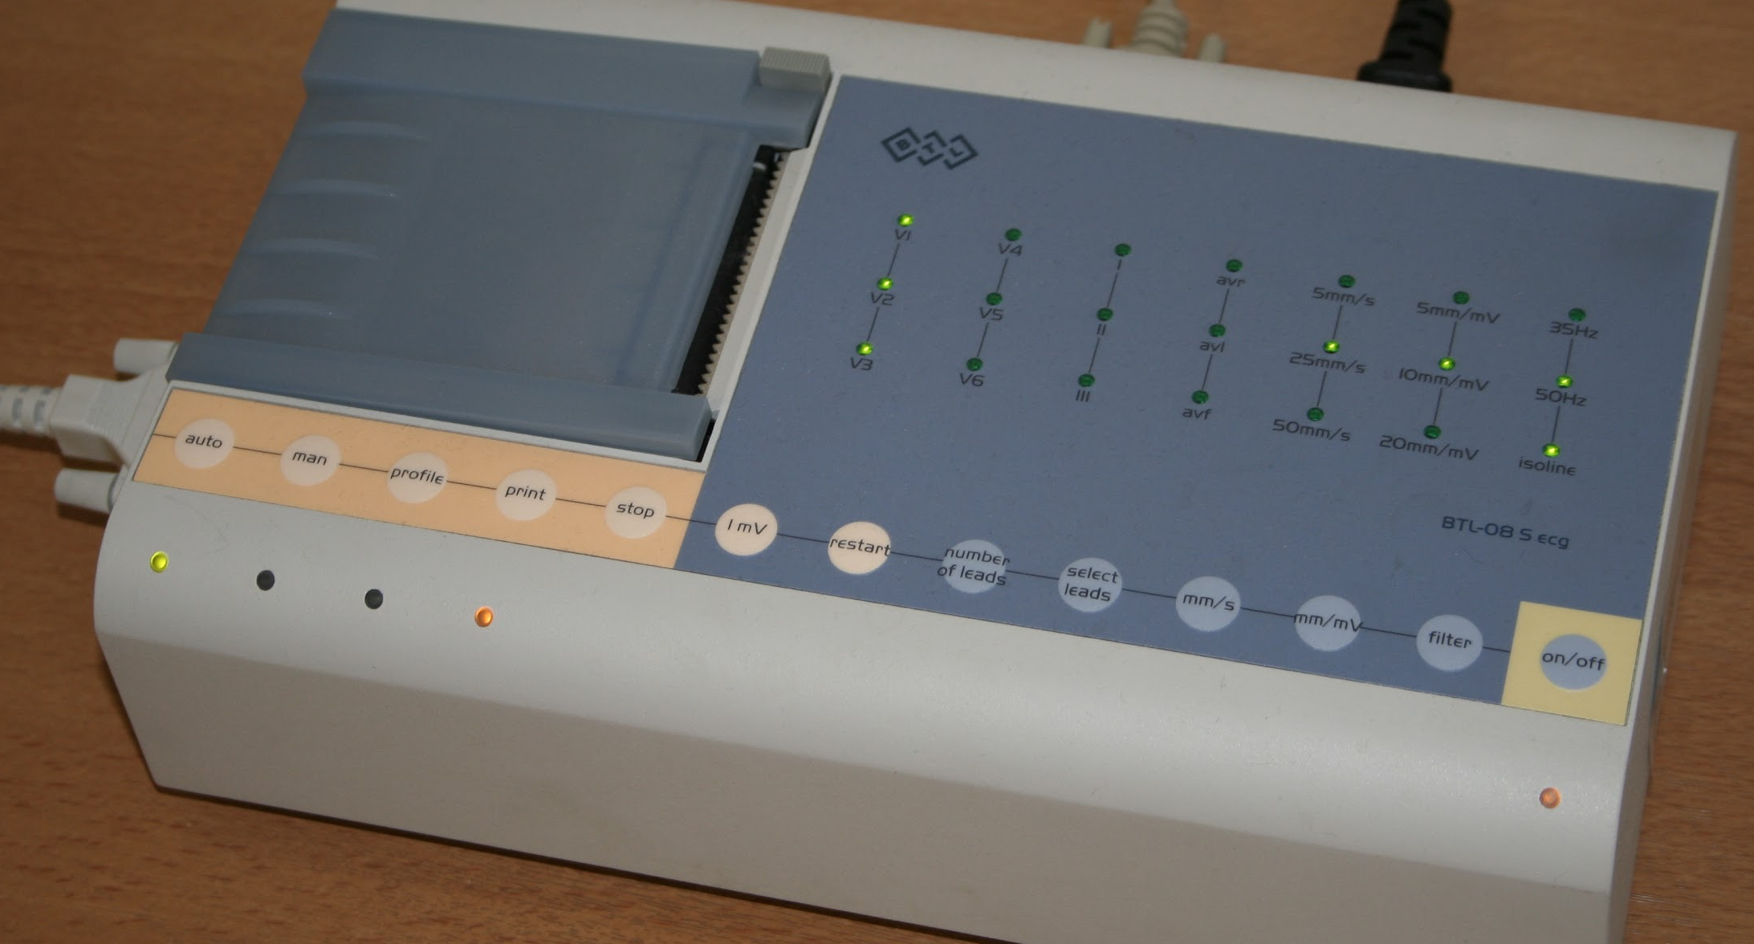
Doctor to Patient Consultation in Bangladesh
TELERAD PACSSERVER
MRI
TELE PATHOLOGY SERVER
iMedix and VC SERVER
A trial run by Softmed LLC, Kolkata.
Rangamati (75 km) from Chattagram.
Between 24/3/21 – 7/12/21
107 Consultations with 42 patients by 5 Doctors.
CT
TELE ECG SEVER
X-RAY
TELE ECG
LOCAL PHYSICIAN
LOCAL PATIENT
TELE PATHOLOGY
HOSPITAL PREMISE
REMOTE PATIENT
REMOTE PHYSICIAN
REMOTE LOCATIONS
Courtesy: Softmed Technologies LLP

Slide 36
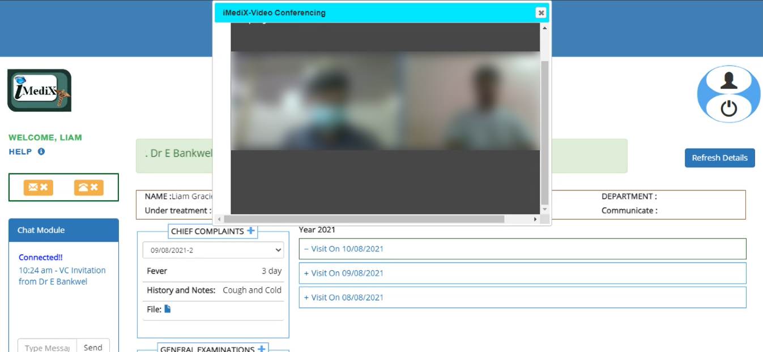
iMediX at BCRT Hospital, IIT KGP
Inaugurated on 2nd October, 2020.
Between 2/10/21 and 26/9/21
Number of registered users: 1438
177 consultations and 107 Prescriptions.
Presently integrated with the recently installed HMIS (July’2023) of the hospital.

Slide 37
Integration with the hospital operations
Accounts created on demand from the users by fetching their data from ERP.
Weekly slots for telemedicine are made available from the hospital with duty rosters for doctors.
Patients book their appointments on those slots to assigned doctors.
Tele-consultations take place in those scheduled periods.
Medicine disbursed from the pharmacy in the hospital with the production of printed and endorsed prescription.

Slide 38
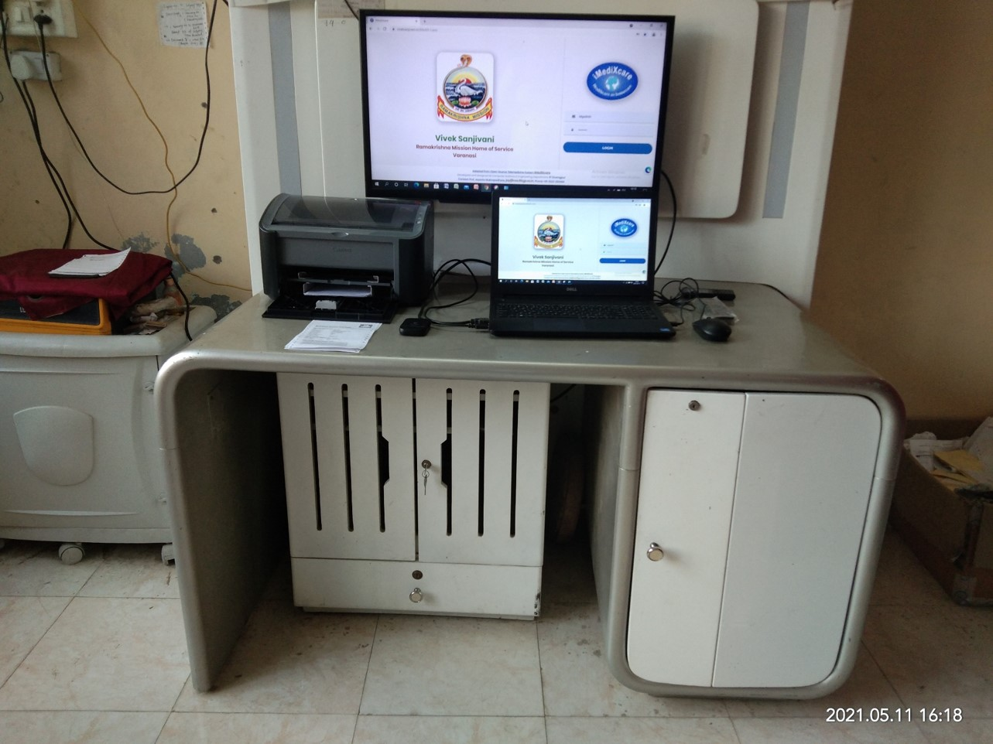
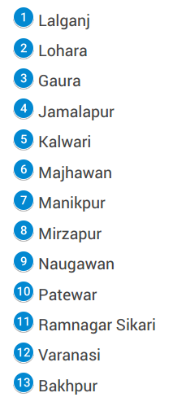
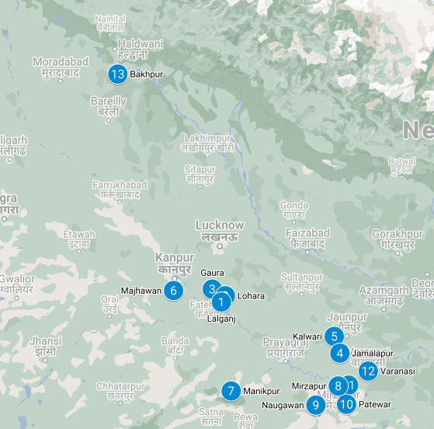
Vivek Sanjivani: Ramakrishna Mission Home of Service Varanasi
Inaugurated 15th March, 2021

Slide 39
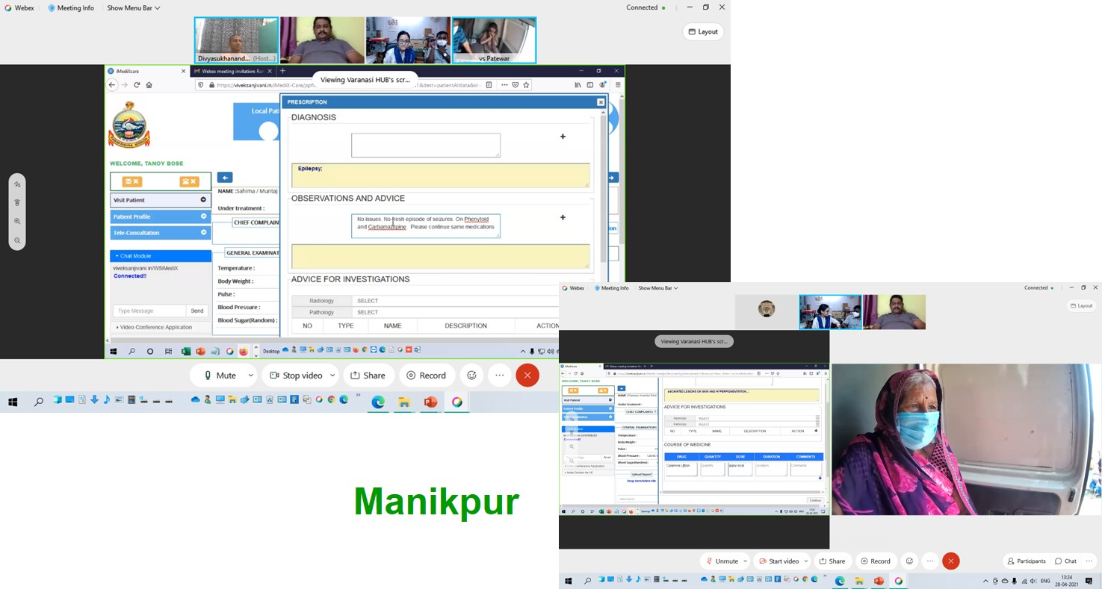
Vivek Sanjivani (Matri Seva)
Adapted from opensource
Community outreach program
Doctors across the globe
Patients at 12 Centres
11 in Uttar Pradesh and 1 in Uttarakhand.
60 – 135 Km (UP), Overnight train journey for the center at Uttarakhand
Equipped with internet connectivity, computer, webcam and printers.
Paramedical staff measure vital signs
Runs pharmacy
Number of patients enroled from 1st April, 21 to 17th Sept 2023: 16587
Number of patients treated from 1st April, 21 to 17th Sept,, 2023: 65131
Average number patients treated/ month = 2170 (approx.)
Number of visits per patient (avg.): 4 (approx.)

Slide 40
Age distribution (gender)

Slide 41
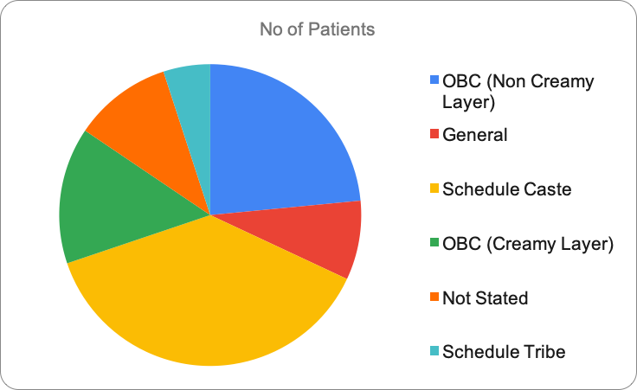
Caste (Social status in Hinduism)

Slide 42
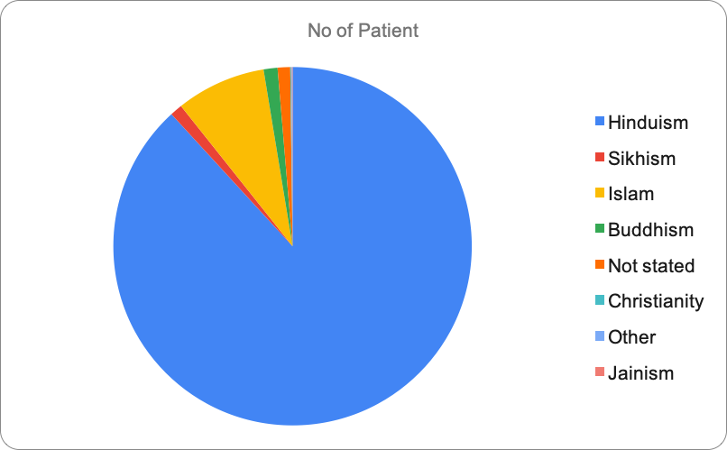
Religion

Slide 43
Advices (Centerwise)

Slide 44
Diagnosis
Anemia
Tinea
ARI
COP
CMD
Severe Mental Disorder
Constipation
Polyarthirits
Diabetes
Osteoarthirits
Itching
Hypertension
Hyperacidity
Epilepsy

Slide 45
Conclusion
Telemedicine should be an integral part of public / community health care system.
Effective and efficient in managing resources and time for delivery of health care.
Health care provider has to play the lead role in integrating this technology in their work place.
Looking for a great healthy future of our public health care system in our country.

Slide 46
Conclusion
Integration of institutional care with homecare is very much needed in the present scenario.
Made the technology available as an open source software.
Implemented and running in a few places
BCRT Hospital at IIT KGP
Ramakrishna Mission Home of Services, Varanasi

Slide 47
Thank You

