Slide 1
Graphical Models-Part I
Jayanta Mukhopadhyay
Dept. of Computer Science and Engg.

Slide 2
Graphical Model
X
Y
P(X)
P(Y|X)
represents the interaction between variables in a graph.
composed of nodes, and arcs between the nodes.
A node: a random variable, X, with the probability of the random variable, P(X).
A directed arc from X to Y: X influences Y with P(Y|X).
A directed acyclic graph (DAG)
No cycle.
Topology called structure and P(X), P(Y|X) are parameters.
also called Bayesian networks, belief networks, probabilistic networks.

Slide 3
An example
Bayesian network modeling
R | W | P(R,W)
R | W | 0.16
~R | W | 0.24
R | ~W | 0.04
~R | ~W | 0.56
Rain
(R)
P(R)=0.2
Sufficient to specify P(R,W)
P(W|R)=0.8
P(W|~R)=0.3
Wet grass
(W)
Marginal Prob.: P(R)= 0.2 & P(W)=0.4

Slide 4
Inference mechanism
Diagnostic Inference:
P(W|R)
= 0.8
Causal Inference:
P(R|W)
= (P(R)P(W|R))/P(W)
=(0.2 x 0.8) / 0.4
=0.4
Knowing that the grass is wet, increases P(R) from 0.2 to 0.4.
Bayesian network modeling
R | W | P(R,W)
R | W | 0.16
~R | W | 0.24
R | ~W | 0.04
~R | ~W | 0.56
Rain
(R)
P(R)=0.2
P(W|R)=0.8
P(W|~R)=0.3
Wet grass
(W)
Directed edge, but
May not imply causality.
Marginal Prob.: P(R)= 0.2 & P(W)=0.4

Slide 5
Formation of a graphical model
Form graph
by adding nodes, and
arcs between two nodes, if they are not independent.
X and Y are independent, if they are not conditionally dependent.
P(Y|X)=P(Y)
and also P(X|Y)=P(X).
P(X,Y)=P(X)P(Y)

Slide 6
Conditional Independence
Conditional independence between X and Y given occurrence of a third event (Z):
If P(X,Y|Z)=P(X|Z)P(Y|Z)
Can also be written as
P(X|Z)=P(X|Y,Z)
Y
Z
Given Z, X and Y are conditionally independent.
Z
Y
X
P(X,Y,Z)=
P(Y) P(Z|Y) P(X|Z)
P(X,Y,Z)=
P(Z) P(X|Z) P(Y|Z)
X
Head to tail connection
Tail to tail connection

Slide 7
Conditional Independence
When its value is known Z blocks the path from Y to X,
if Z is removed, there is no path between Y to X.
Given Z, X and Y are independent.
Y
Z
P(X,Y|Z)=P(X|Z)P(Y|Z)
Z
Y
X
P(X,Y,Z)=
P(Y) P(Z|Y) P(X|Z)
P(X,Y,Z)=
P(Z) P(X|Z) P(Y|Z)
X
Head to tail connection
Tail to tail connection

Slide 8
Conditional Independence
For specifying joint probabilities, no need to specify at all possible data points.
Instead of 8 specifications, only 5 needed!
Significant saving for a large network.
P(C)
#: 1
Cloudy
P(C)
Cloudy
P(C|R)
#: 2
Rain
P(S|C)
P(R|C)
P(W|R)
#:2
Sprinkler
Rain
Wet Grass
Head to tail connection
Tail to tail connection

Slide 9
Inference / Diagnosis from conditional Independence
To compute probabilities of all possible combinations of other variables, given a value of a leaf node.
Y
Knowing X, infer about Z and then Y.
Z
Knowing X, infer about Z and then Y.
Z
Y
X
P(X,Y,Z)=
P(Y) P(Z|Y) P(X|Z)
P(X,Y,Z)=
P(Z) P(X|Z) P(Y|Z)
X
Head to tail connection
Tail to tail connection

Slide 10
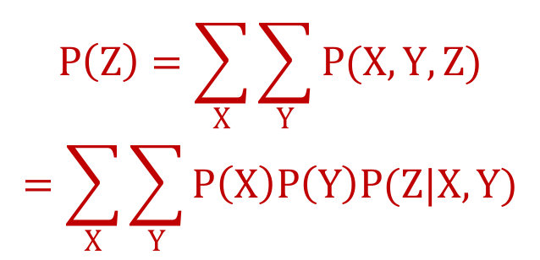
Head to head connection
X and Y are independent, but become dependent when Z is known.
The path from X and Y is blocked if Z is not observed (independent), else not blocked (dependent through Z).
P(X)
#:1
X
Y
P(Y)
#:1
$$P(X,Y|Z)≠P\left(X | Z\right)P(Y|Z)$$
P(X,Y|Z)=P(X,Y,Z)/P(Z)
Z
P(Z|X,Y)
#:4
$$P\left(Z\right)=\sum_{X}{\sum_{Y}{P(X,Y,Z)}}$$
$$=\sum_{X}{\sum_{Y}{P\left(X\right)P\left(Y\right)P(Z|X,Y)}}$$
P(X,Y,Z)=P(X) P(Y) P(Z|X,Y)
P(X,Y)=P(X)P(Y)

Slide 11
Bayesian Networks: Larger graphs from simpler graphs
Propagating implied conditional independency.
Cloudy
P(C)
#:1
Explicitly encode independencies
Allow breaking down inference into calculation over small groups of variables
Propagated from evidence nodes to query nodes.
P(S|C)
#:2
P(R|C)
#:2
Sprinkler
P(C,S,R,W):Instead of 16, only 9 parameters needed.
Rain
Wet grass
P(W|S,R)
#:4
P(C,S,R,W)=P(C) P(R|C) P(S|C) P(W|S,R)

Slide 12
Computation on Bayesian Network
Given the value of any set of variables as an evidence infer the probabilities of any other set of variables.
A probabilistic database
a machine that can answer queries regarding the values of random variables.
the difference between unsupervised and supervised learning becomes blurry.

Slide 13
Thank you!

