Slide 1
Gait Recognition
by
Jayanta Mukhopadhyay
Dept. of Computer Science and Engineering,
Indian Institute of Technology, Kharagpur

Slide 2
Collaborators
Dr. Aditi Roy
Prof. Shamik Sural

Slide 3
Motivation
Surveillance
works even at low resolution from a distance.
difficult to camouflage.
captured without walker’s attention.
Communication
informative gestures, emotions.
Biometry
unique for a person.

Slide 4
Context
Surveillance under a controlled walking environment:
Airport security
Corridor Walk
Recognition of persons through gait in free environment.
Human Computer Interaction through gait analysis.

Slide 5
Challenges
Discriminating Features not well understood.
Style of walking.
Human profile.
Coordinated movement to limbs, and torso.
Speed of walking.
High degree of Freedom (or variation) of movement of subjects.
Orientation of torso, carrying condition, etc.
Presence of multiple subjects.
Occlusion.

Slide 6
Our context
Fronto-parallel view.
Corridor walk.
Camera fixed.
Multiple subjects.
Occlusion.

Slide 7

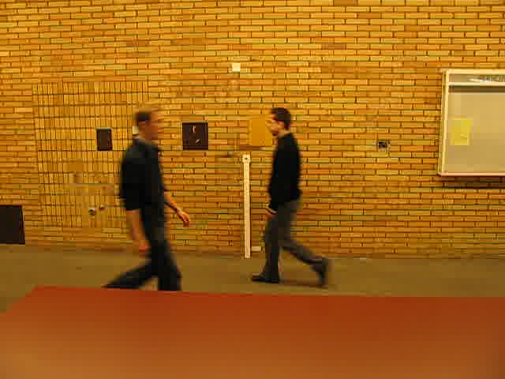
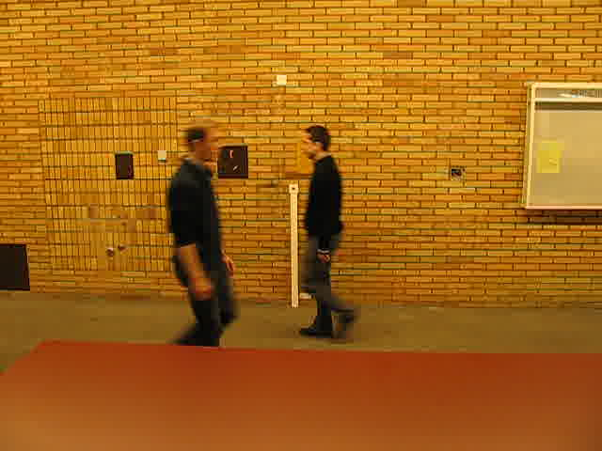
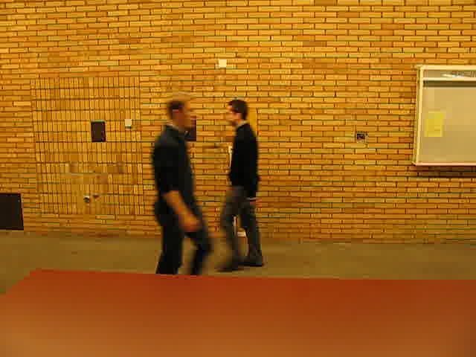
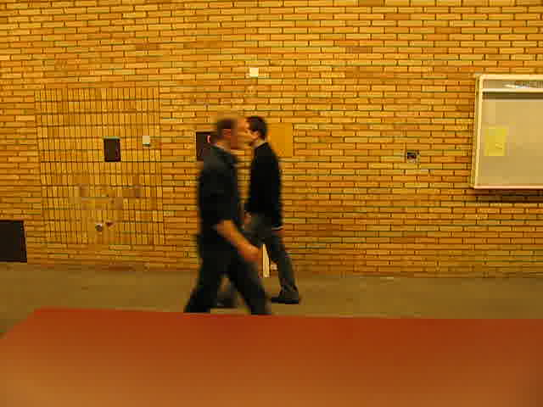
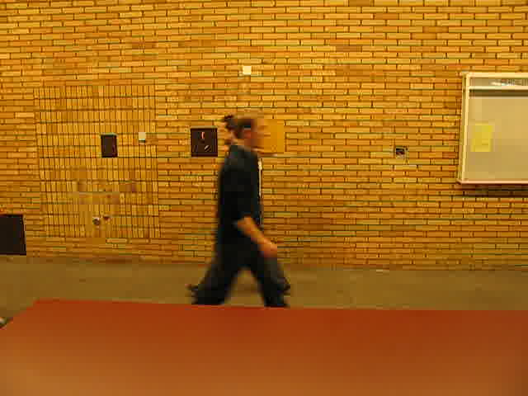
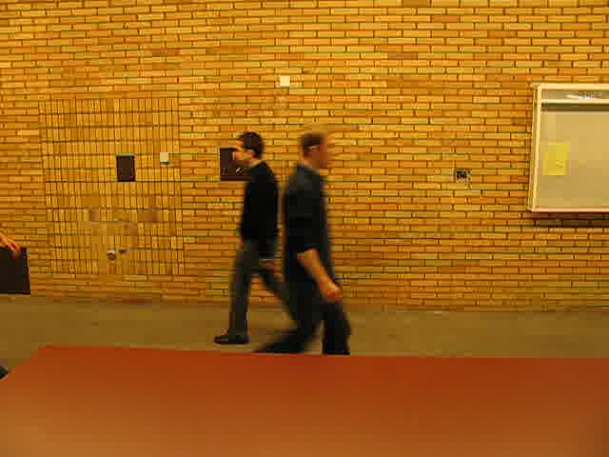
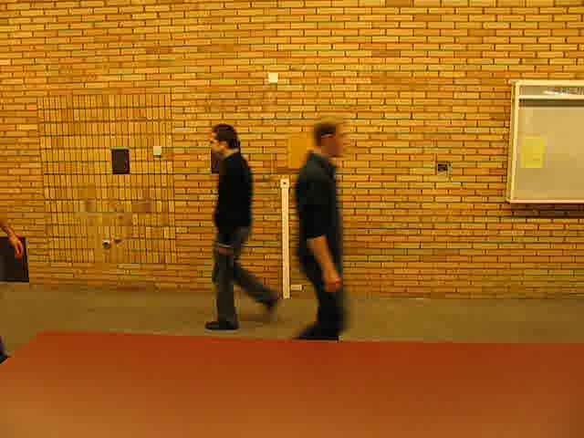
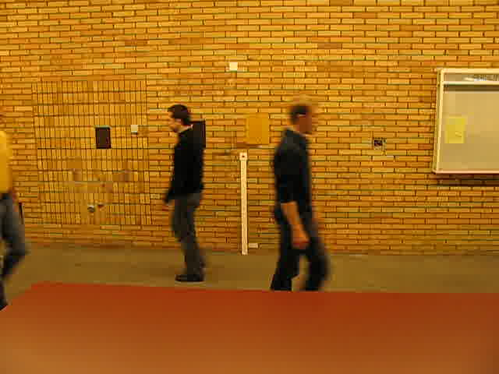
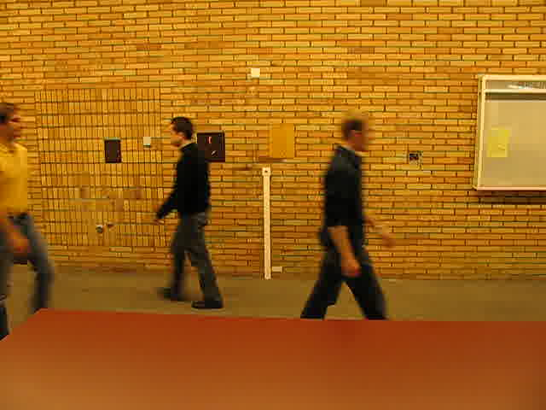
Example of an image sequence
1 2 3
4 5 6
7 8 9
A sequence of frames showing occlusion

Slide 8
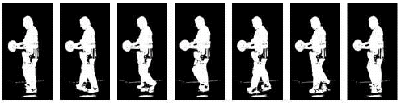
Gait
Gait – Style of walking
Gait Shape – Configuration or shape of the people as they perform different gait phases
Gait Dynamics – Rate of transition between these phases
Sequence of frames in a gait cycle

Slide 9
Problem of gait recognition
Recognition of a person walking in that view.
Sub-tasks
  Select appropriate gait feature
  Detect occlusion in videos
  Reconstruct the degraded/ occluded images
  Recognize subjects from the reconstructed images

Slide 10
Gait Recognition : Traditional Approach
Learning
Training video
Extract Silhouettes
Segment Gait Cycles
Compute Gait Features
Database
Test video
Recognition
Gait Feature Computation
Classification
Extract Silhouettes
Segment Gait Cycles
Recognition Result

Slide 11
Existing Approaches
Gait Recognition Approaches
Model based Approach [CVIU’03, ETRI’11]
Motion based Approach
State-space Methods [TIP’04,PR’11,MSEEC’11]
Spatio-temporal Methods [PAMI’06,SP’08,PAMI’05,SP’10,ICIP’11]

Slide 12
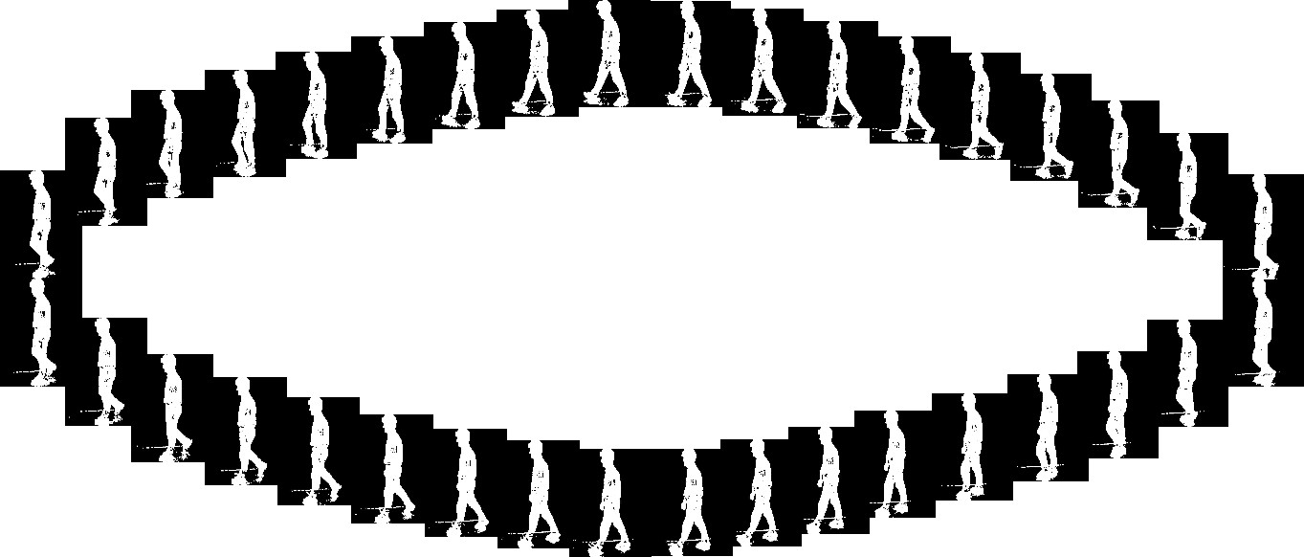
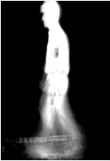
Gait Cycle and GEI
Temporal template based gait feature [PAMI’06, SP’08, SP’10, TIP’12] simple, robust representation, good recognition accuracy
Intrinsic dynamic information is not preserved properly less discriminative

Slide 13
Gait Recognition in the Presence of Occlusion
Learning
Training Silhouette Sequence
Key Pose Estimation
Silhouette Classification
Gait Feature Computation
Database
Test Silhouette Sequence
Recognition
Silhouette Classification
Clean and Unclean Gait Cycle Detection
Clean Gait Cycle Present?
Nearest Neighbor Classification
No
Gait Feature Computation
Recognition Result
Yes
Reconstruction of Occluded Silhouettes by GPDM
Block diagram of the overall approach for gait recognition in the presence of occlusion

Slide 14
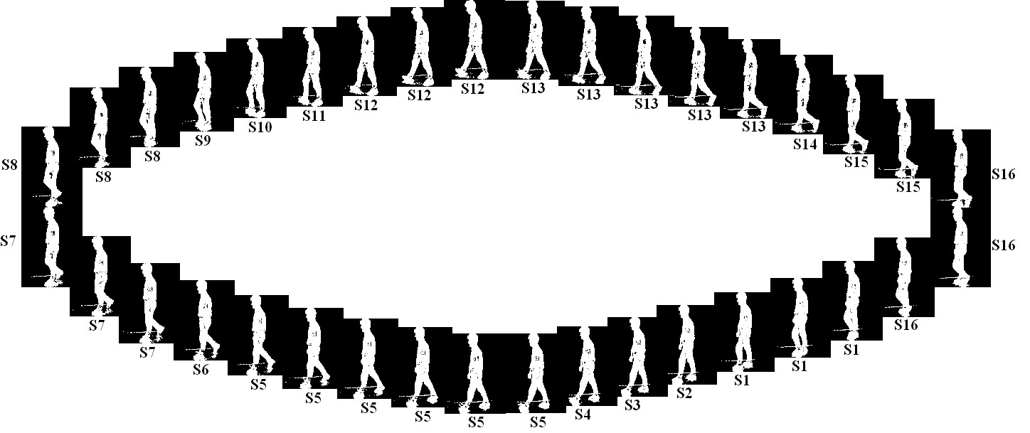
Key poses
    Pose Kinematics captures pure dynamics
    Pose Energy Image (PEI) captures change of shape in different key poses
Silhouette count for key pose classes 1-16 is
[3 1 1 1 6 1 3 3 1 1 1 3 5 1 2 3].

Slide 15

Pose Kinematics (PK)
Percentage of time (Gait Cycle Period) spent in different key pose states.
The i^{th} element (PK_{i}) of the vector represents the fraction of time i^{th} pose (P_{i}) occurred in a complete gait cycle
where GC is the number of frames in the complete gait cycle, F_{t} is the t^{th} frame in the sequence and P_{i} is the i^{th} key pose

Slide 16

Pose Energy Image (PEI)
A Pose Energy Image (PEI) is the average image of all the silhouettes in a gait cycle which belong to a particular pose state
Given the silhouette image I_{t}(x; y) corresponding to frame F_{t} at time t in a sequence, i^{th} gray-level pose energy image (PEI_{i}) is defined as follows:

Slide 17
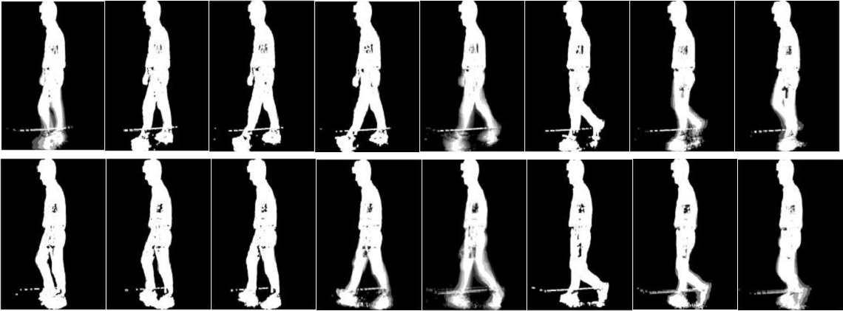
PEI Images
PEI images obtained from the sequence. Corresponding Pose Kinematics feature vector is {0.0833, 0.0278, 0.0278, 0.0278, 0.1667, 0.0278, 0.0833, 0.0833, 0.0278, 0.0278, 0.0278, 0.0833, 0.1389, 0.0278, 0.0556, 0.0833}.

Slide 18
Key Pose Estimation and Silhouette Classification
Key Pose Estimation
Training
Silhouette
Sequence
Eigen Space
Projection
K-means Clustering
Database
Transformation
Matrix
Test
Silhouette
Sequence
Match Score
Computation
Most Probable
Path Search
Eigen Space
Projection
Classification of
Silhouettes into
Key poses
Silhouette Classification
Block diagram of key pose estimation and silhouette classification into the estimated key pose classes

Slide 19
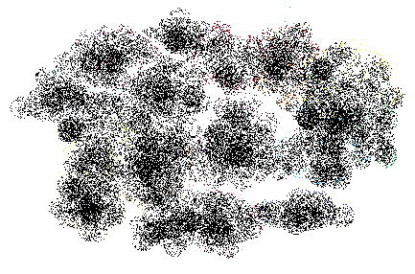
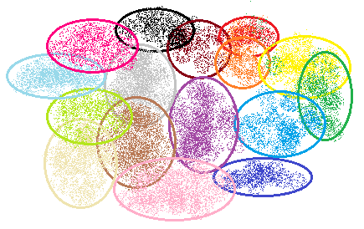
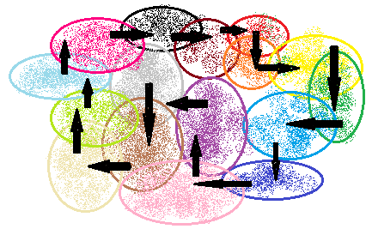


















Key Pose Estimation
.
.
.
Eigen Space Projection

Slide 20
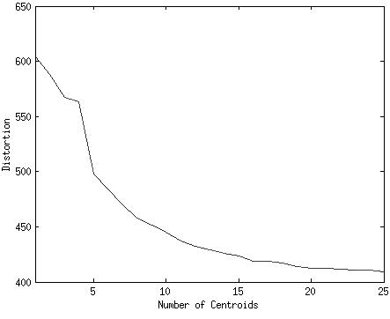
Key Pose Estimation
Fig. 4. Distortion characteristics plot
Fig. 5. Key poses obtained from K-means clustering in Eigen Space

Slide 21
Silhouette Classification into Key Poses
Observations:
  Silhouettes can be easily distorted by a bad foreground segmentation, thus the matching score may be misleading
  Even if silhouettes are clean, different poses may generate similar silhouettes (like left foot forward position and right foot forward position)
Decision based only on individual matching scores is unreliable
Temporal constraints are imposed by the state transition model
Formulate the key pose finding problem as the most likely path finding problem in a directed graph

Slide 22
State Transition Diagram
Proposed state transition diagram considering five states (S1-S5) corresponding to five key poses (P1-P5)
In our experimentation 16 key pose states are considered

Slide 23
Directed Graph Construction
Directed acyclic graph constructed for five key pose states (S1-S5) over five frames. The bold edges show the most probable path found by dynamic programming. The pose assignment obtained for each frame is: S1-S1-S2-S3-S4(1-1-2-3-4)

Slide 24
Human Recognition
Similarity Value> Threshold
Compute PK
Compute Similarity
Yes
Training silhouettes with corresponding key pose label
Compute PEI
Apply PCA/LDA
No
Transformation Matrix
Compute PK
Result
Test silhouettes with corresponding key pose label
Select a set of most probable classes
Compute PEI
Feature Space Transformation
Compute Similarity
Flow chart of human recognition method using PEI and PK features

Slide 25
Data Sets
Data Set | No. of Subjects | Environment | Parameters
MoBo[[CMU’01] | 25 | Indoor, treadmill | View point, carrying condition, surface, walking speed
USF[PAMI’05] | 122 | Outdoor | View point, carrying condition, surface, shoe, time (months)

Slide 26
Results
[AFGR’02a]
[CVPR’04a]
[AFGR’02b]
[ASP’04]
[CVPR’07]
Gallery: Train
Probe: Test
S: Slow walking
F: Fast walking
B: Ball in hand
I: Inclined surface
Performance of our algorithm across all types of gallery/probe combinations shows the best classification accuracy
Recognition result with only Pose Kinematics is not high enough, as expected
Accuracy with only PEI followed by PCA is higher than any of the existing methods

Slide 27
Results
The average accuracy is obtained by taking average of all accuracies for different types of experiments performed in Table 1
Time requirement using Pose Kinematics is low, as expected
PEI requires 83% higher computational time than Pose Kinematics
After hierarchical combination of the two features, the time requirement is reduced by 18% compared to the PEI method alone

Slide 28
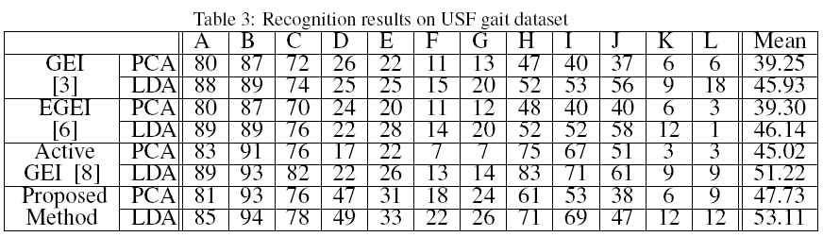
Results
[PAMI’06]
[SP’08]
[SP’10]
According to the weighted mean recognition results over all the 12 probes, our PEI and Pose Kinematics based approach outperforms all of the existing gait feature representation methods
Weight proportional to Number of Samples

Slide 29
Results
Cumulative match characteristics curves of all the probe sets
The weighted mean accuracy almost saturates (at 75 - 85%) beyond a rank value of 12

Slide 30
Occlusion Detection
Detect missing key poses, if any.
Extract clean and unclean gait cycles from the whole input sequence.
Reconstruct the occluded silhouettes in the next stage

Slide 31
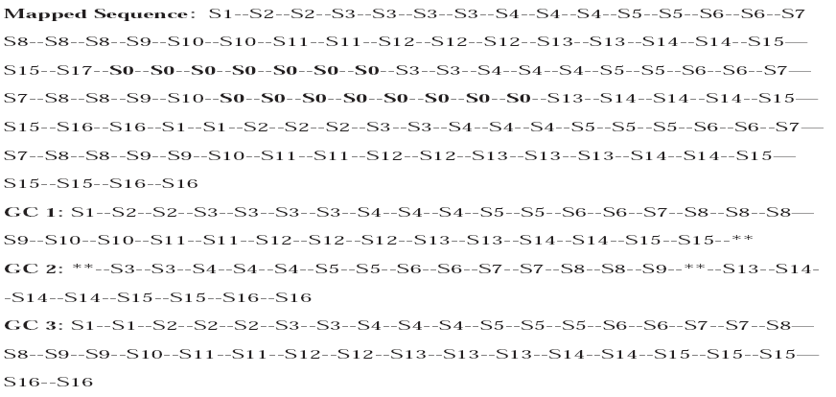
Fig. 15. Output of the pose estimation step. Mapped Sequence shows class of each frame of the input sequence. Index labels ‘S1’ to ‘S16’ denote one of the sixteen key poses and index label ‘S0’ denotes occluded pose. From this mapped sequence, three extracted sub-sequences are shown as GC 1, GC 2, and GC 3. Subsequence GC 1 and GC 2 are unclean and GC 3 is clean. ‘*’ indicates presence of occluded frame (s).

Slide 32
State Transition Diagram
Proposed state transition diagram considering three states (S1-S3) corresponding to three key poses (P1-P3) and one occluded pose state (O)
Example Graph

Slide 33
Silhouette Reconstruction
Gaussian Process Dynamic Models (GPDM) applied to model the silhouette observations and their dynamics.
A latent variable probabilistic model for high dimensional nonlinear time series data (in our case silhouette sequence).
A non-linear mapping between the observation space and the latent space.
It learns dynamical model from missing data and produces estimates of them

Slide 34
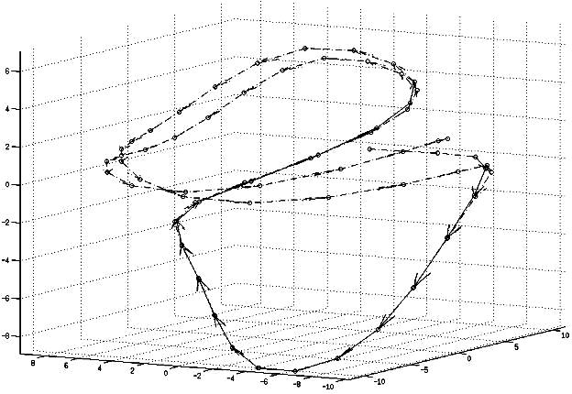
Gaussian Process Dynamical Model (GPDM)
Latent positions and corresponding trajectories learnt from a silhouette sequence of 2 gait cycles using GPDM. The silhouette sequence contains 2 gait cycles of size 34 frames. 20 silhouettes were occluded, thus considered as missing. Latent trajectory for the existing silhouette data is depicted by dash-dot curve and the regular curve shows the estimated missing silhouette latent positions.

Slide 35
Data Sets
Data Set | Real Occlusion Present | Synthetic Occlusion Type | Occlusion Model Used
TUM-IITKGP* | Yes | Static, Dynamic | Yes
MoBo [CMU’01] | No | Static | No
*TUM-IITKGP data set. http://www.mmk.ei.tum.de/∼hom/tumgait/.

Slide 36
Results on TUM-IITKGP Data Set

Slide 37
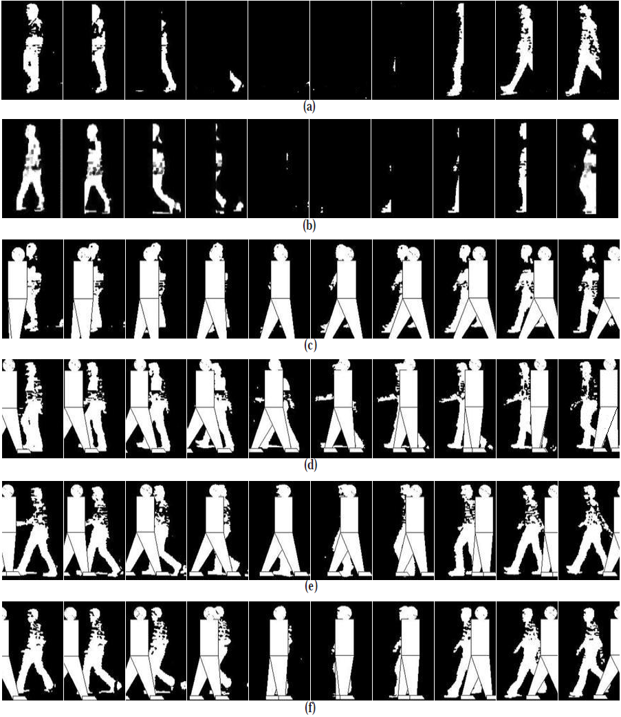
Example sequences of the synthetically occluded TUM-IITKGP data set:
(a) static occlusion with midstance initial phase of motion of the target subject,
(b) static occlusion with double support initial phase of motion of the target subject,
(c) dynamic occlusion with MS-MS initial phases of motion of the target subject and the occluder, respectively,
(d) dynamic occlusion with MS-DS initial phases of motion of the target subject and the occluder, respectively,
(e) dynamic occlusion with DS-MS initial phases of motion of the target subject and the occluder, respectively,
(f) dynamic occlusion with DS-DS initial phases of motion of the target subject and the occluder, respectively.

Slide 38
Example mapped sequence for real static occlusion. First gait cycle starts from frame no. 1 (S6), but the end is overlapped with the next gait cycle due to occlusion. Thus both the gait cycles are detected as unclean.

Slide 39
Example mapped sequence for real dynamic occlusion. First gait cycle, starting from frame no. 1 (S8) and ending at frame no. 33(S7), is detected as unclean as occluded poses are present or all the key poses are not present. Second gait cycle, starting from frame no. 34, is incomplete.

Slide 40
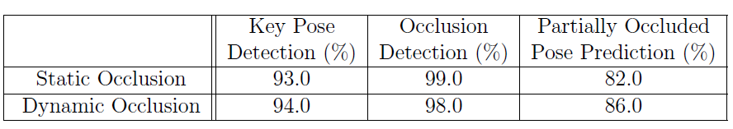
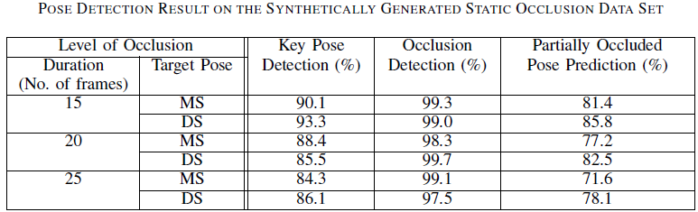
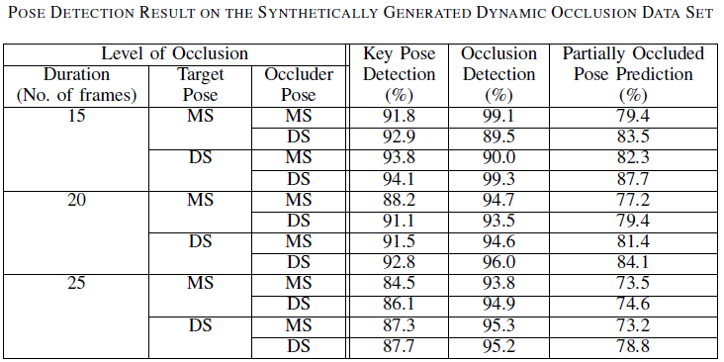
key pose detection accuracy decreases gradually with increasing duration of occlusion
initial phase of motion does not have any clear impact
partially occluded pose prediction accuracy is higher for DS PoM than the MS PoM
partially occluded pose prediction accuracy is highest for DS-DS and lowest for MS-MS
key pose detection accuracy decreases gradually with increasing duration of occlusion

Slide 41
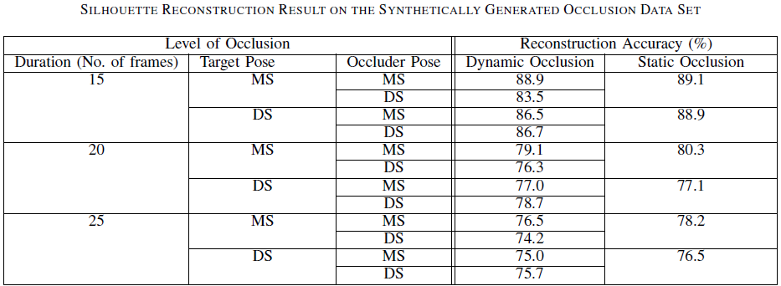
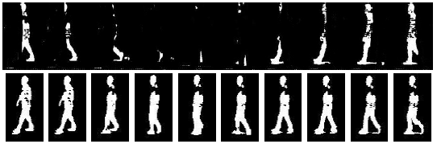
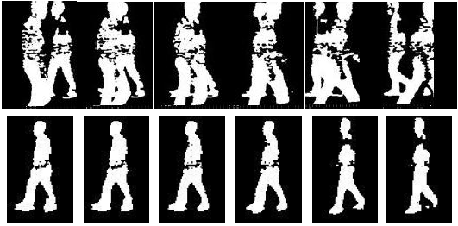


For real occlusion data set, silhouette reconstruction accuracy is 88.9% for dynamic occlusion and 90.7% for static occlusion
reconstruction accuracy falls with increased duration of occlusion
MS PoM contributes highest accuracy. MS-DS /DS-DS situations gives lower accuracy than the MS-MS /DS-MS
MS PoM is better reconstructed than DS PoM
Occluded silhouettes (first row) and reconstructed silhouettes (second row) of a subject during dynamic occlusion
Occluded silhouettes (first row) and reconstructed silhouettes (second row) of a subject during static occlusion
Reconstructed silhouettes of a subject (first row) and corresponding original silhouettes of the subject. (second row)

Slide 42
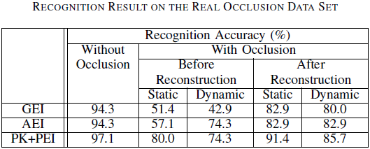
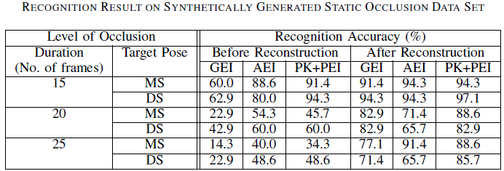
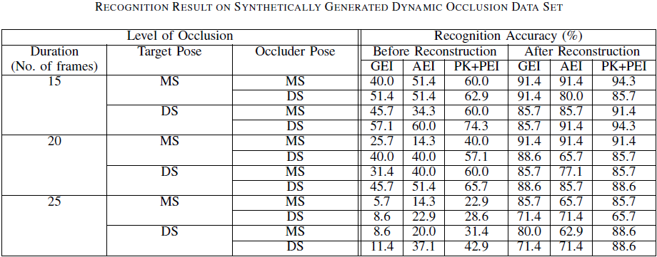
lower average reconstruction accuracy in DS PoM than MS PoM causes lower recognition accuracy in DS than MS
accuracy of MS PoM is worse
than the DS PoM for the same duration of occlusion
best reconstruction accuracy in MS-MS causes maximum average recognition accuracy using any approach
DS-DS contributes highest accuracy whereas MS-MS gives lowest.

Slide 43
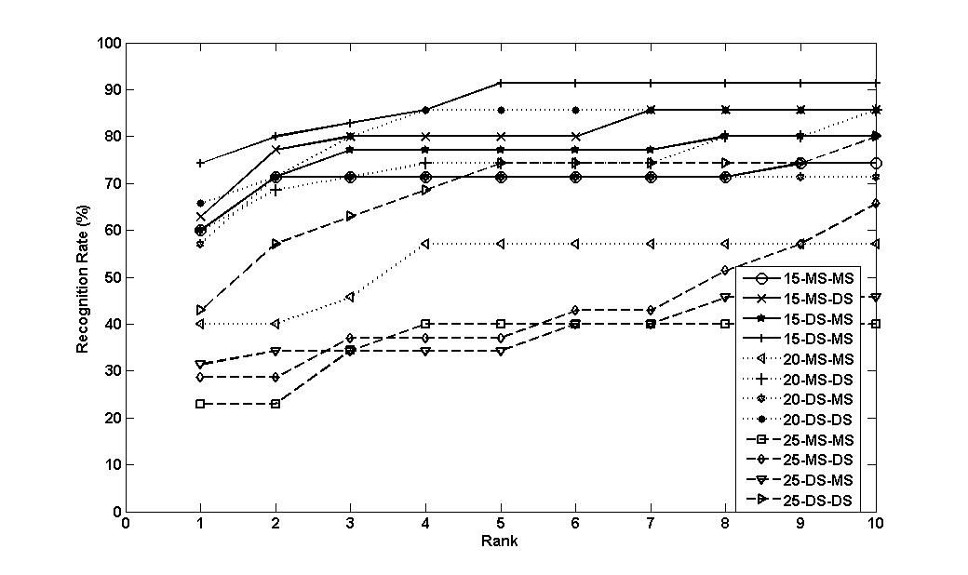
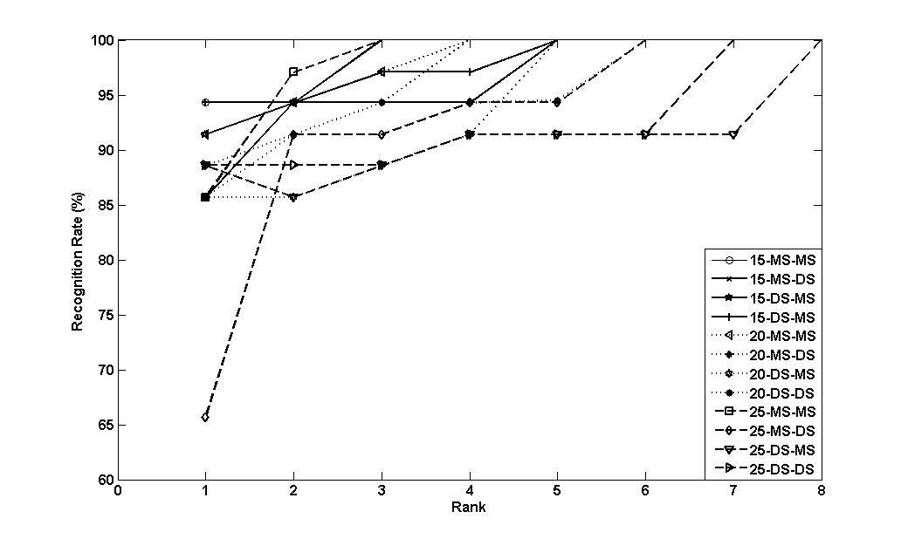
DS PoM always yields better recognition accuracy for any rank than MS PoM. Accuracy almost saturates beyond a rank value of 6.
Beyond a rank value of 7, recognition accuracy attains the 100% limit
(a) (b)
CMC curves showing recognition accuracy of the PK + PEI method on the data set having six levels of static occlusion: (a) before reconstruction (b) after reconstruction
DS-DS performs better at any rank than the other three cases for the same duration of occlusion. Accuracy almost saturates beyond a rank value of 8.
Beyond a rank value of 8, recognition accuracy attains the 100% limit
(a) (b)
CMC curves showing recognition accuracy of the PK + PEI method on the data set having six levels of static occlusion: (a) before reconstruction (b) after reconstruction

Slide 44
Results on MoBo Data Set

Slide 45
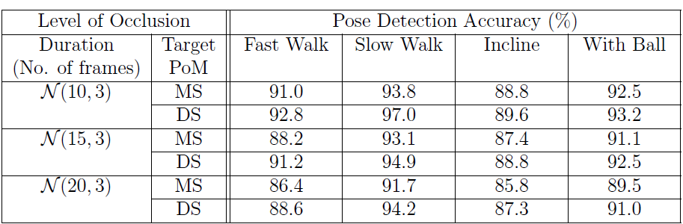
Pose Detection Result on Mobo Data Set
Pose detection accuracy drops with increasing degree of occlusion
DS PoM causes higher pose detection than the MS PoM
Accuracy for inclined plane is lower than the other walking types
Slow walking contributes highest overall accuracy for all the levels of occlusion

Slide 46
Reconstructed missing silhouettes (top 2 rows) and corresponding original silhouettes (bottom 2 rows)

Slide 47
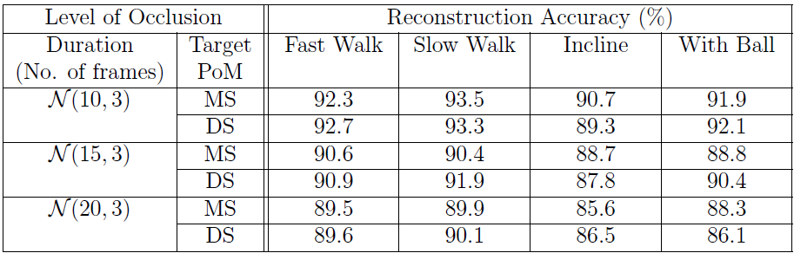
Silhouette Reconstruction Result on Mobo Data Set
Reconstruction accuracy degrades gracefully with increased degree of occlusion
Reconstruction accuracy for walking on inclined plane is lower due to the presence of background noise in the lower leg region
Variation in reconstruction accuracy for different initial phases of motion is less for fast and slow walk while it is slightly higher for walking in inclined plane and for walking with ball in hand

Slide 48
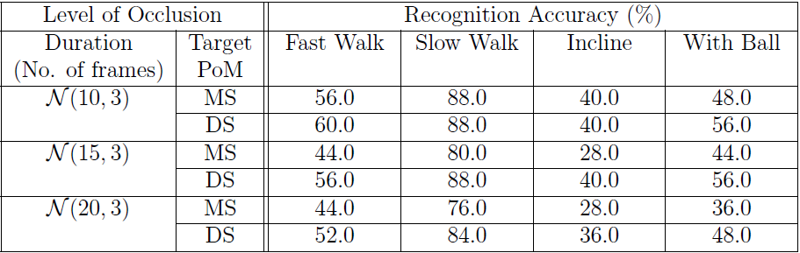
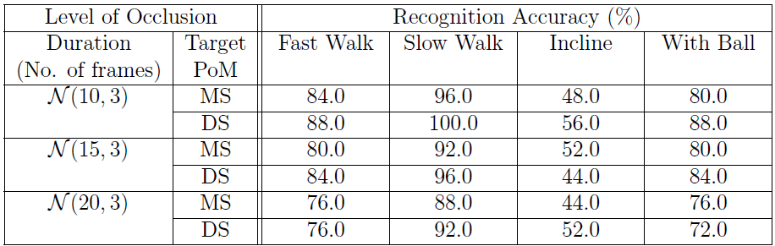
Recognition Result on Mobo Data Set
Recognition Result Before Reconstruction
accuracy for DS PoM is higher than the MS PoM, for all durations
since the reconstruction accuracy of MS PoM
is better than DS, the recognition accuracy with MS PoM is higher than DS
Recognition Result After Reconstruction

Slide 49
Conclusion
New gait features like Pose Kinematics and Pose Energy Image, provide better performance than the existing feature set like Gait Energy Image.
Occlusion can be handled better using Pose Kinematics.
Reconstruction of frames from occlusion improves the performance significantly.

Slide 50
References
A. Roy, S. Sural, J. Mukherjee: A hierarchical method combining gait and phase of motion with spatiotemporal model for person re-identification. Pattern Recognition Letters 33(14): 1891-1901 (2012).
A. Roy, S. Sural, J. Mukherjee: Gait recognition using Pose Kinematics and Pose Energy Image. Signal Processing 92(3): 780-792 (2012).
A. Roy, S. Sural, J. Mukherjee, G. Rigoll: Occlusion detection and gait silhouette reconstruction from degraded scenes. Signal, Image and Video Processing 5(4): 415-430 (2011)

Slide 51
THANK YOU

